Slide 1
Autoscaling All Things in Kubernetes
Class 7

Slide 2
In Kubernetes, several things are referred to as "autoscaling"
Horizontal Pod Autoscaler
Vertical Pod Autoscaler
Cluster Autoscaler
Those autoscalers belong to different categories because they address other concerns.

Slide 3
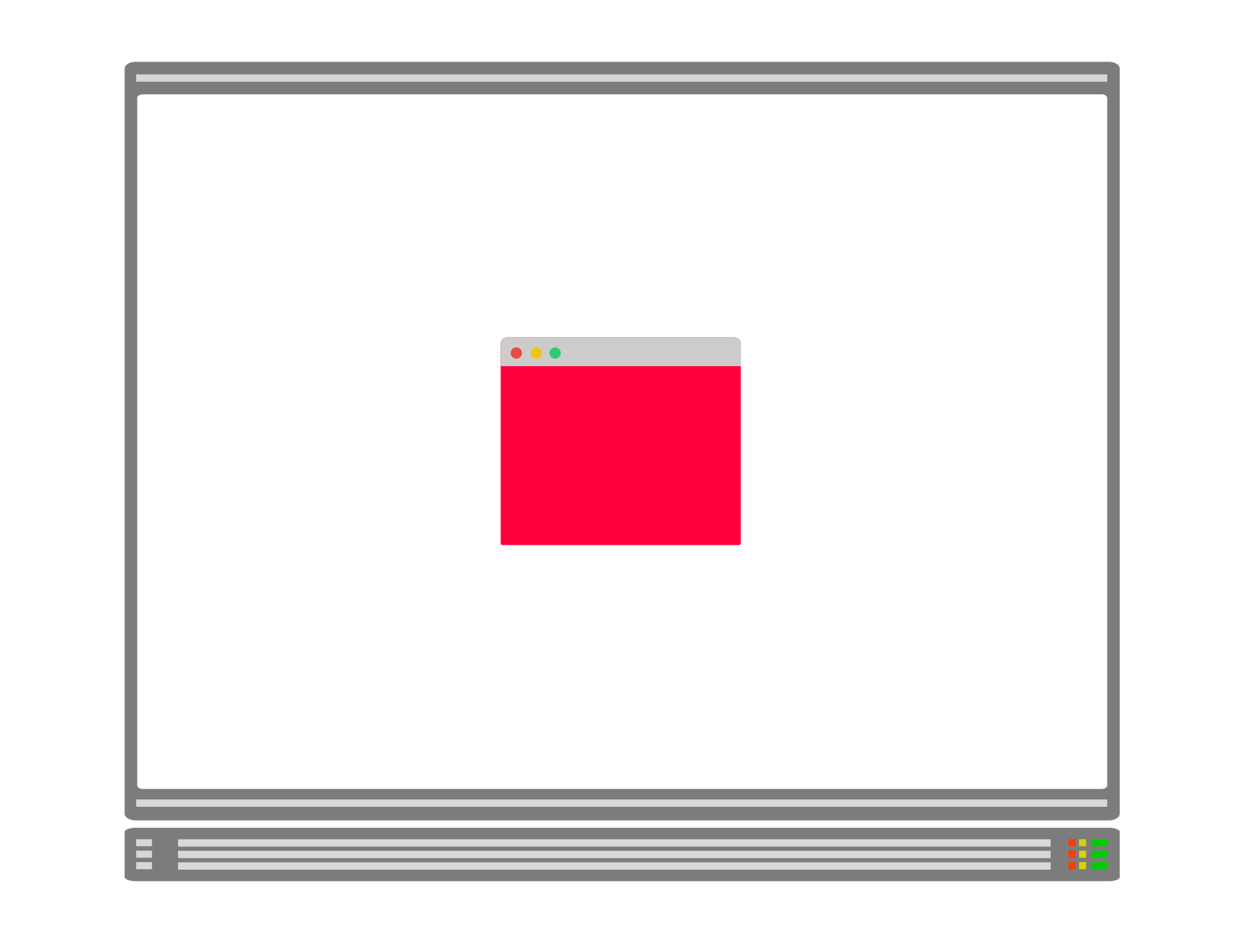
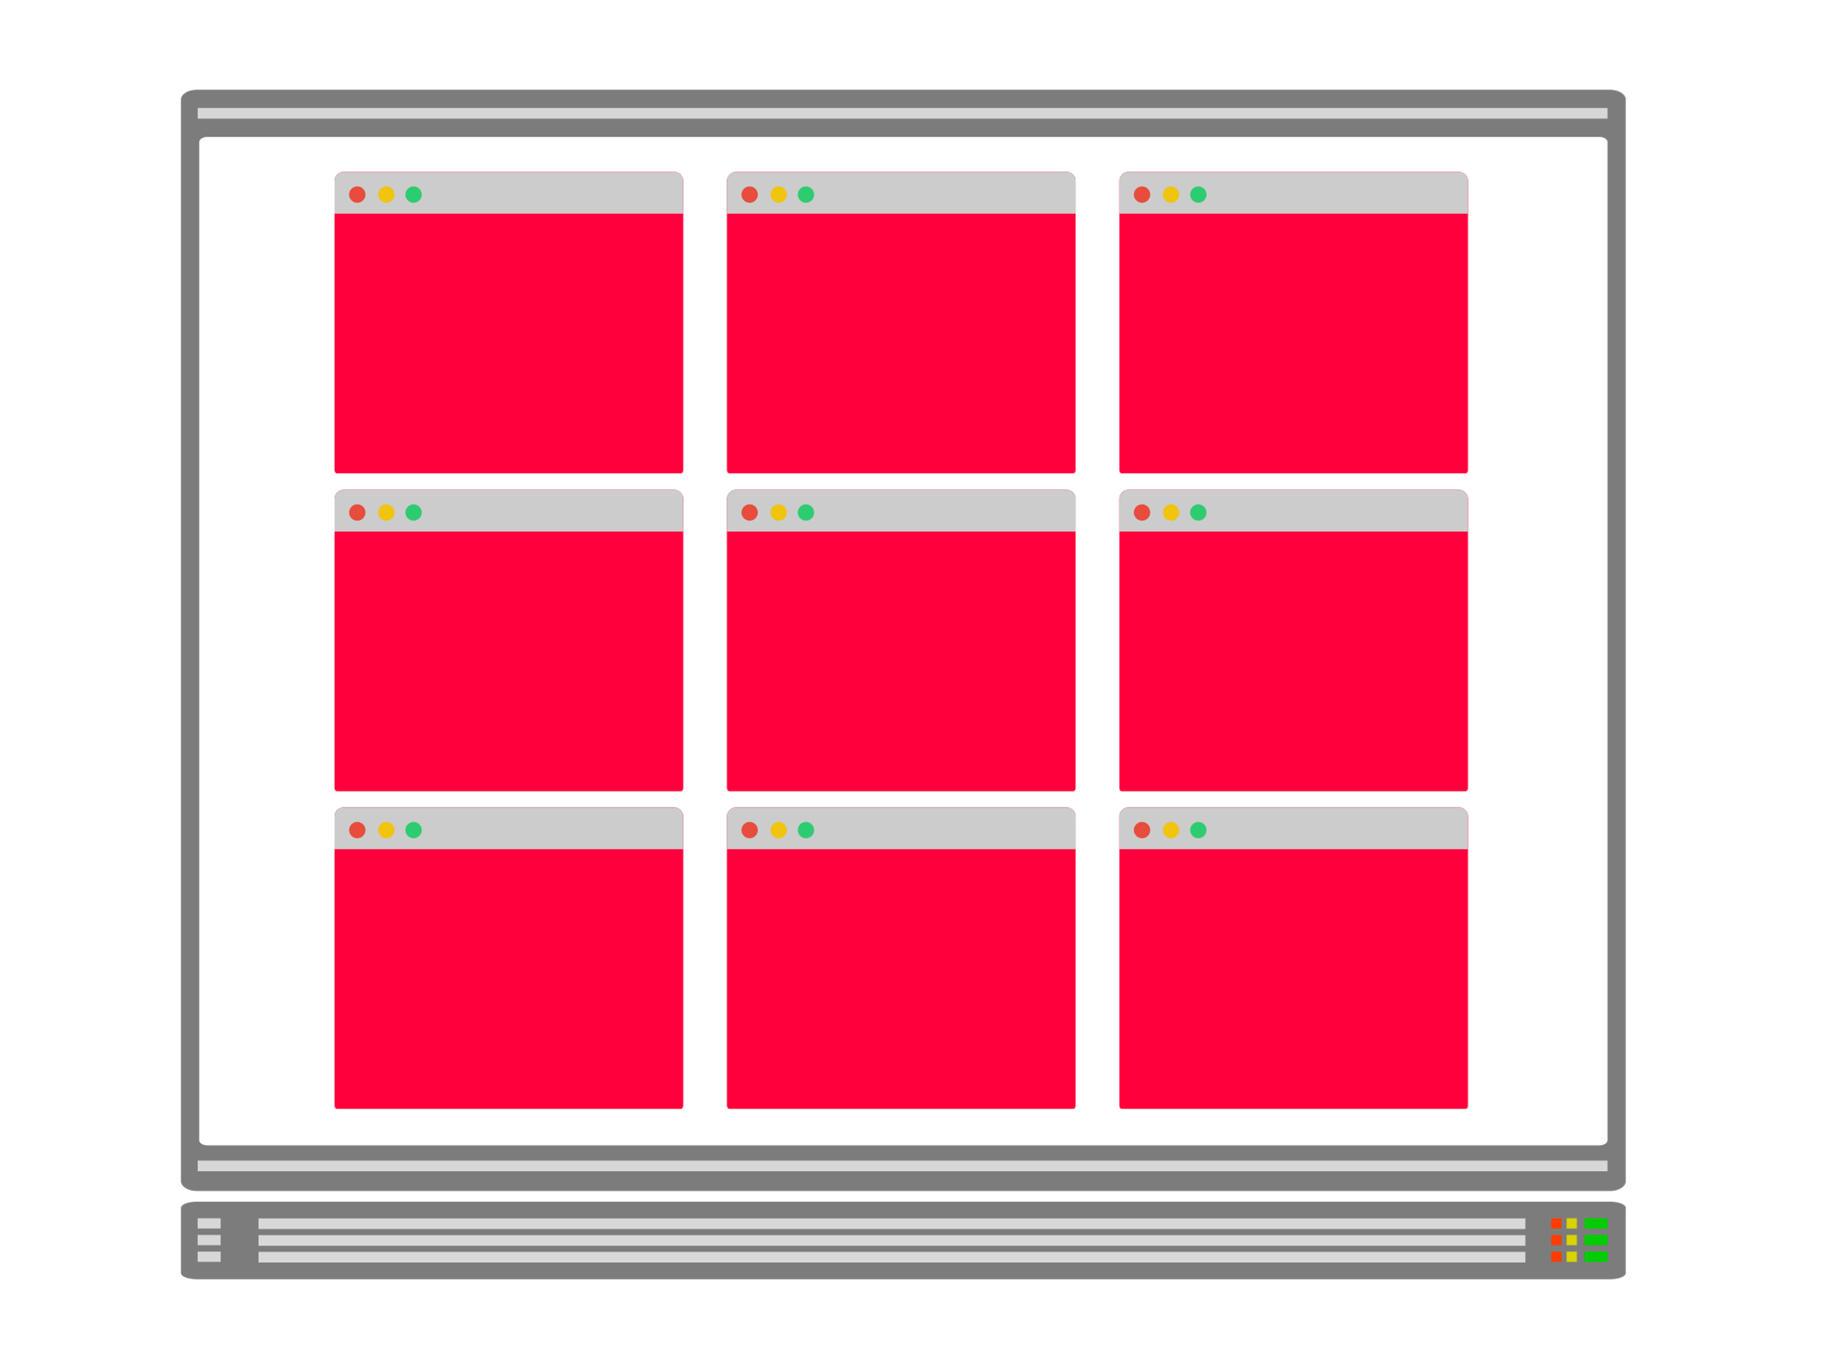
Horizontal Pod Autoscaler (HPA)
The HPA is designed to increase the replicas in your deployments.
As your application receives more traffic, you could have the autoscaler adjusting the number of replicas to handle more requests
The HPA inspects metrics such as memory and CPU at a regular interval
If the metrics pass a user-defined threshold, the autoscaler creates more Pods

Slide 4
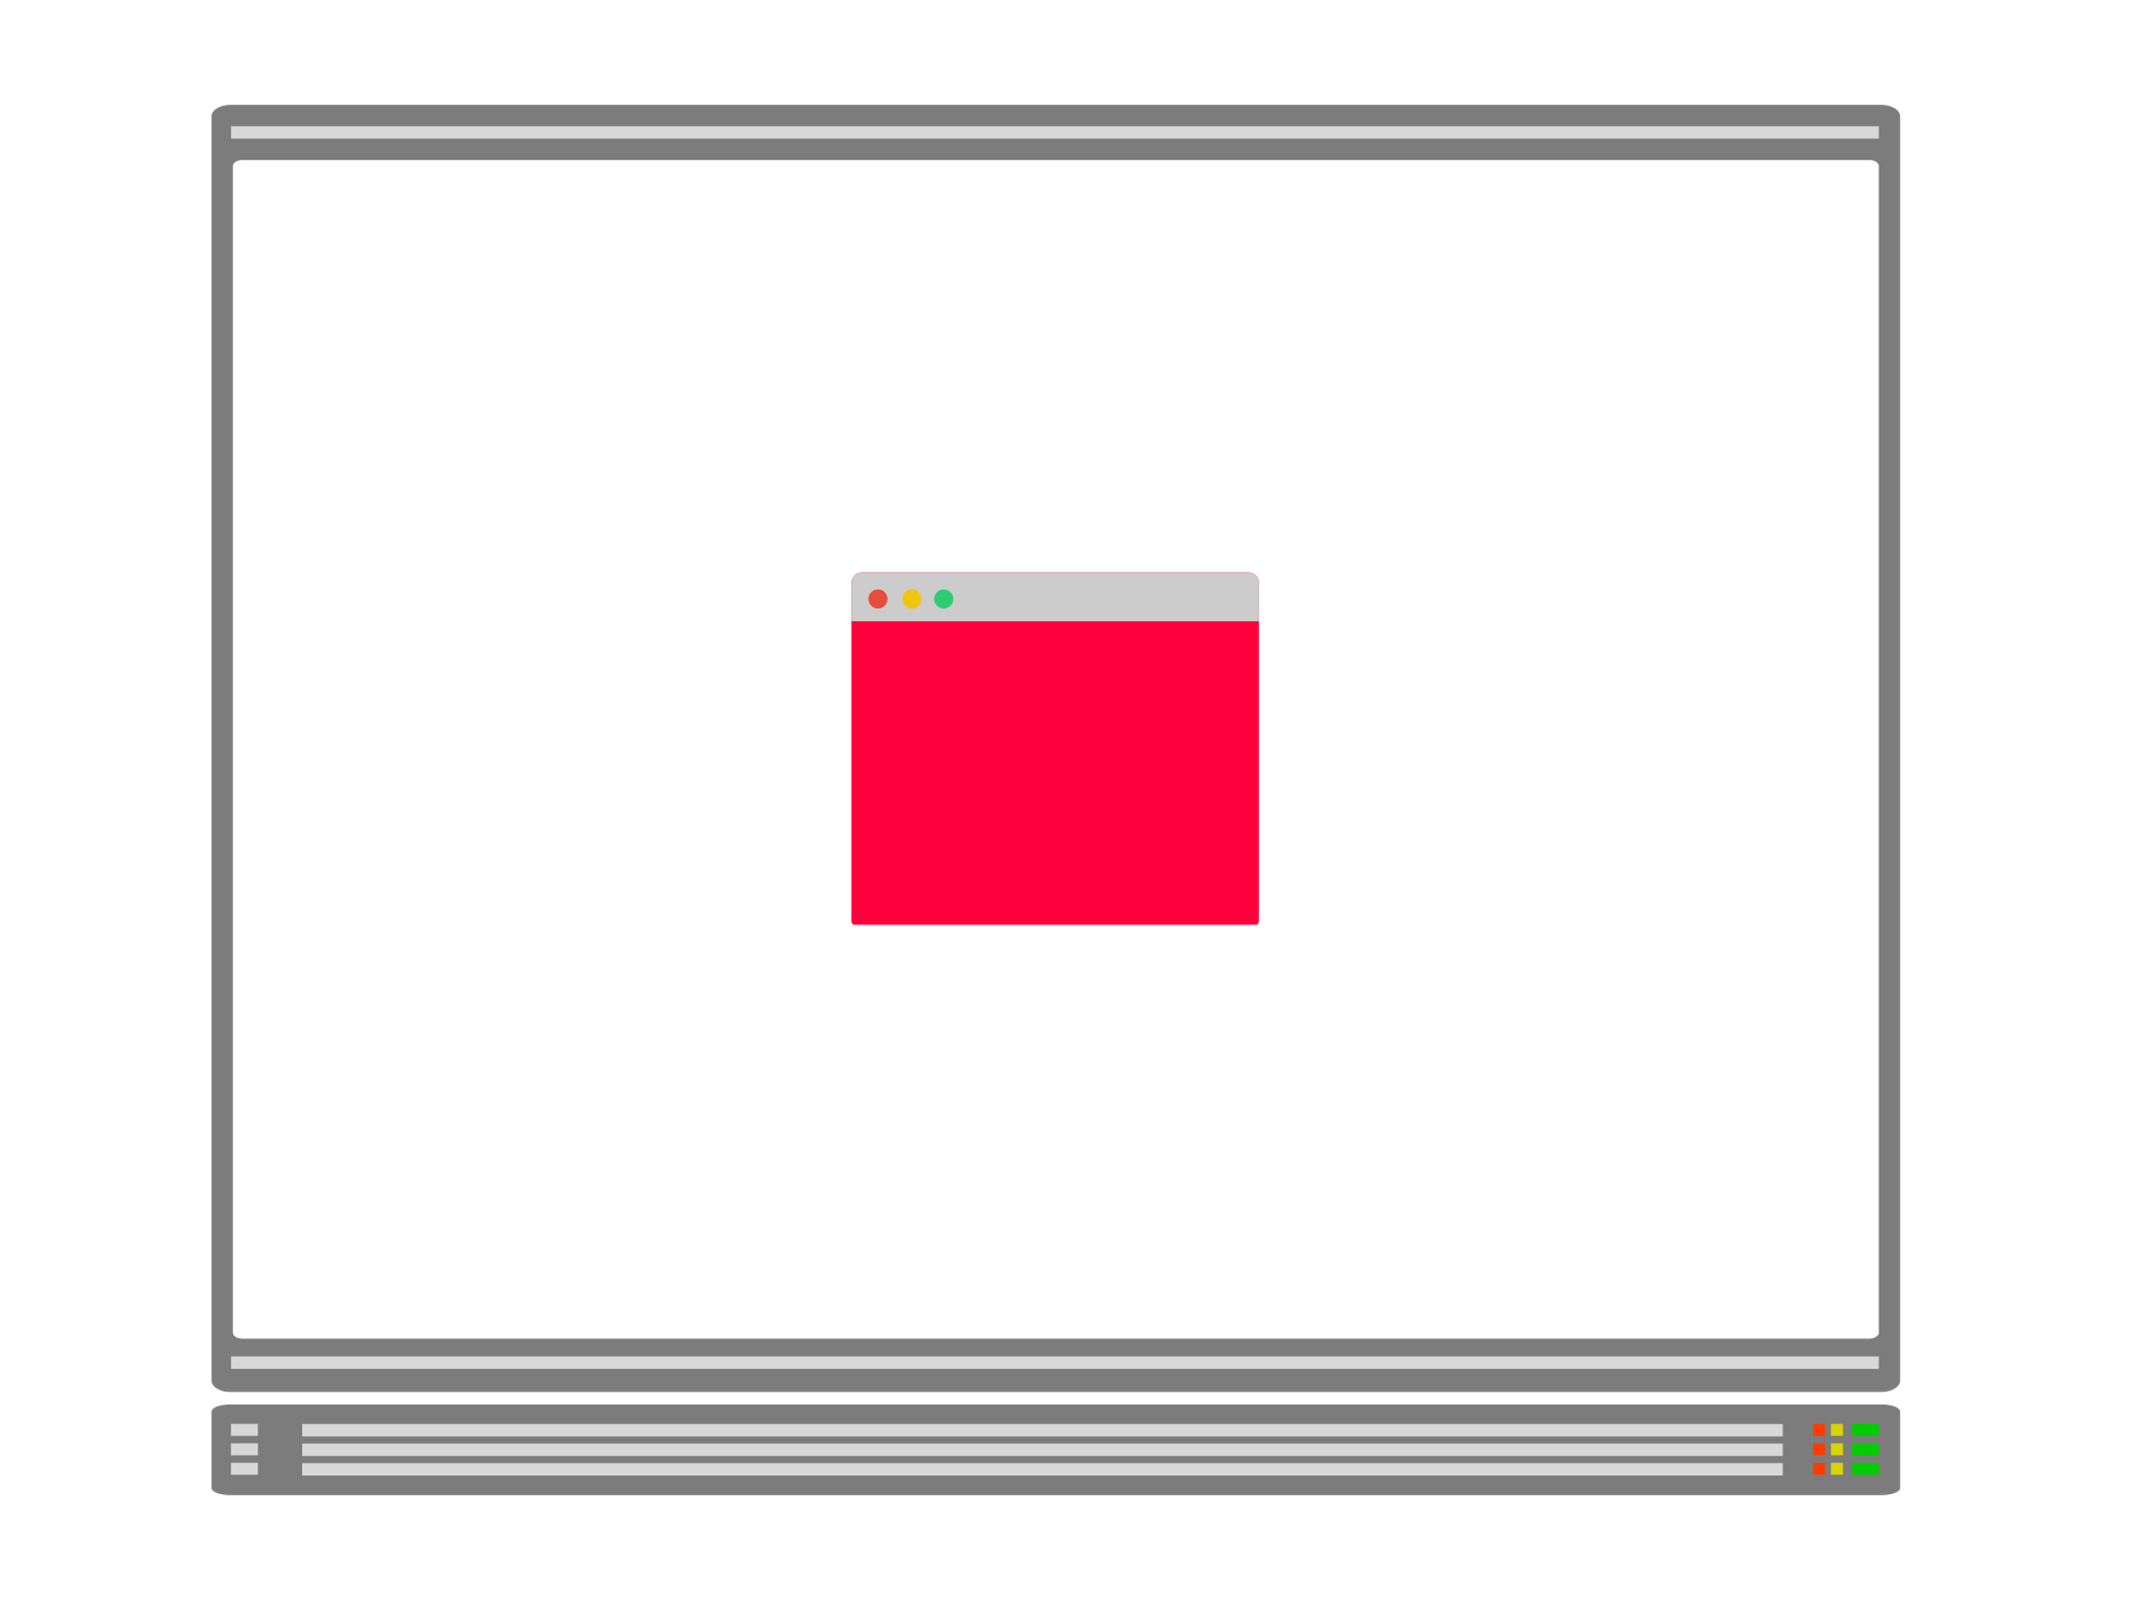

Vertical Pod Autoscaler (VPA)
The VPA is useful when you can't create more copies of your Pods, but you still need to handle more traffic
E.g., you can't scale a database (easily) only by adding more Pods
A database might require sharding or configuring read-only replicas
But you can make a database handle more connections by increasing the memory and CPU available to it
That's precisely the purpose of the vertical autoscaler — increasing the size of the Pod

Slide 5
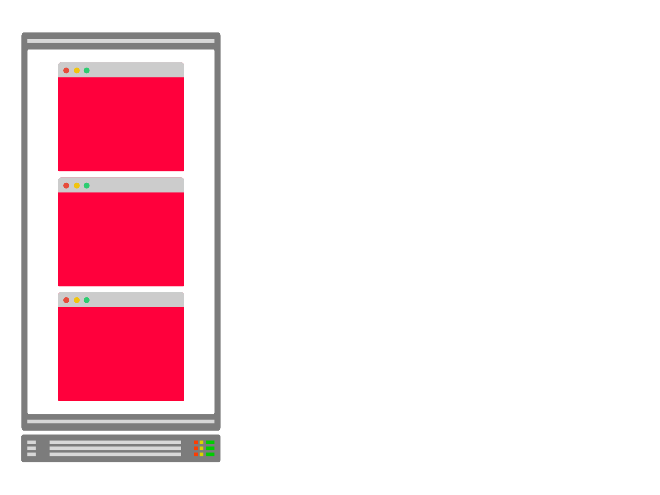
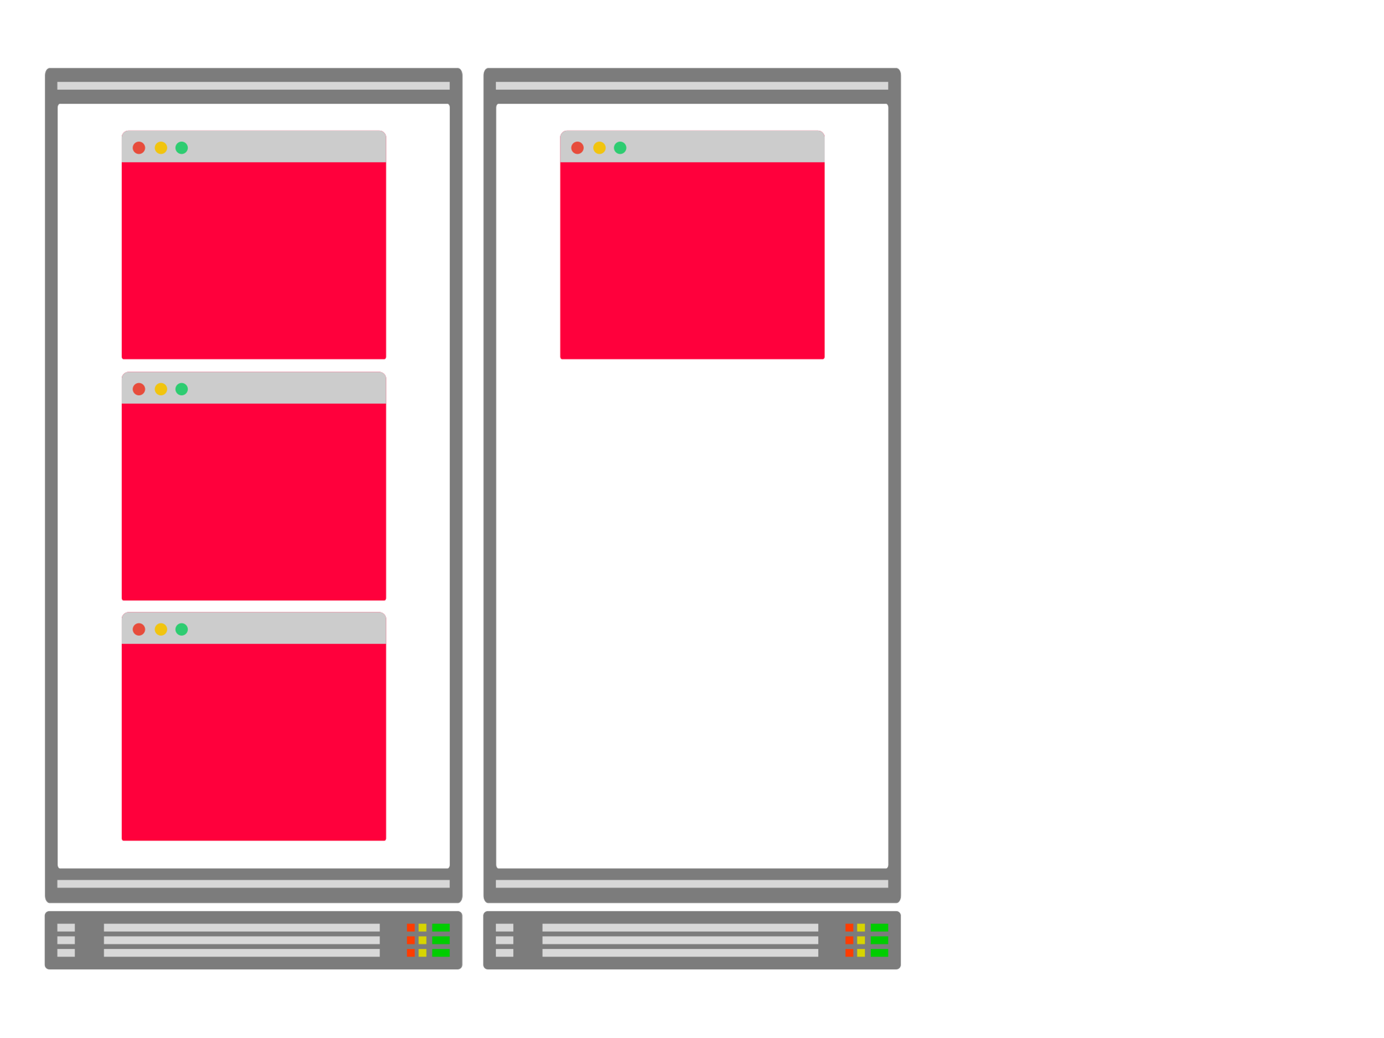
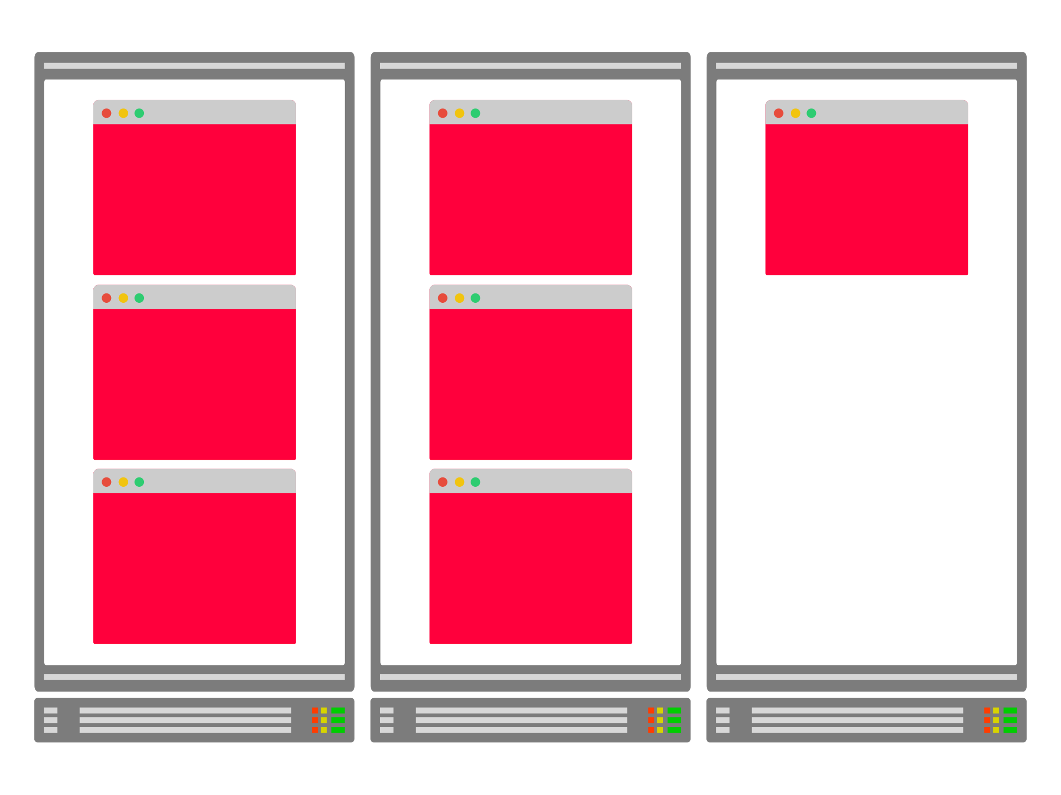
Cluster Autoscaler (CA)
When your cluster runs low on resources, the Cluster Autoscaler provision a new compute unit and adds it to the cluster.
If there are too many empty nodes, the cluster autoscaler will remove them to reduce costs.
When you scale your pods in Kubernetes, you might run out of space.
The Cluster Autoscaler is designed to increase the node count in your cluster.
You can keep scaling your pods without worrying about the underlying nodes. The cluster autoscaler will create more automatically.

Slide 6
While these components all "autoscale" something…
They are entirely unrelated to each other
They all address very different use cases and use other concepts and mechanisms.
And they are developed in separate projects and can be used independently from each other.
However, scaling your cluster requires fine-tuning the setting of the autoscalers so that they work in concert.

Slide 7
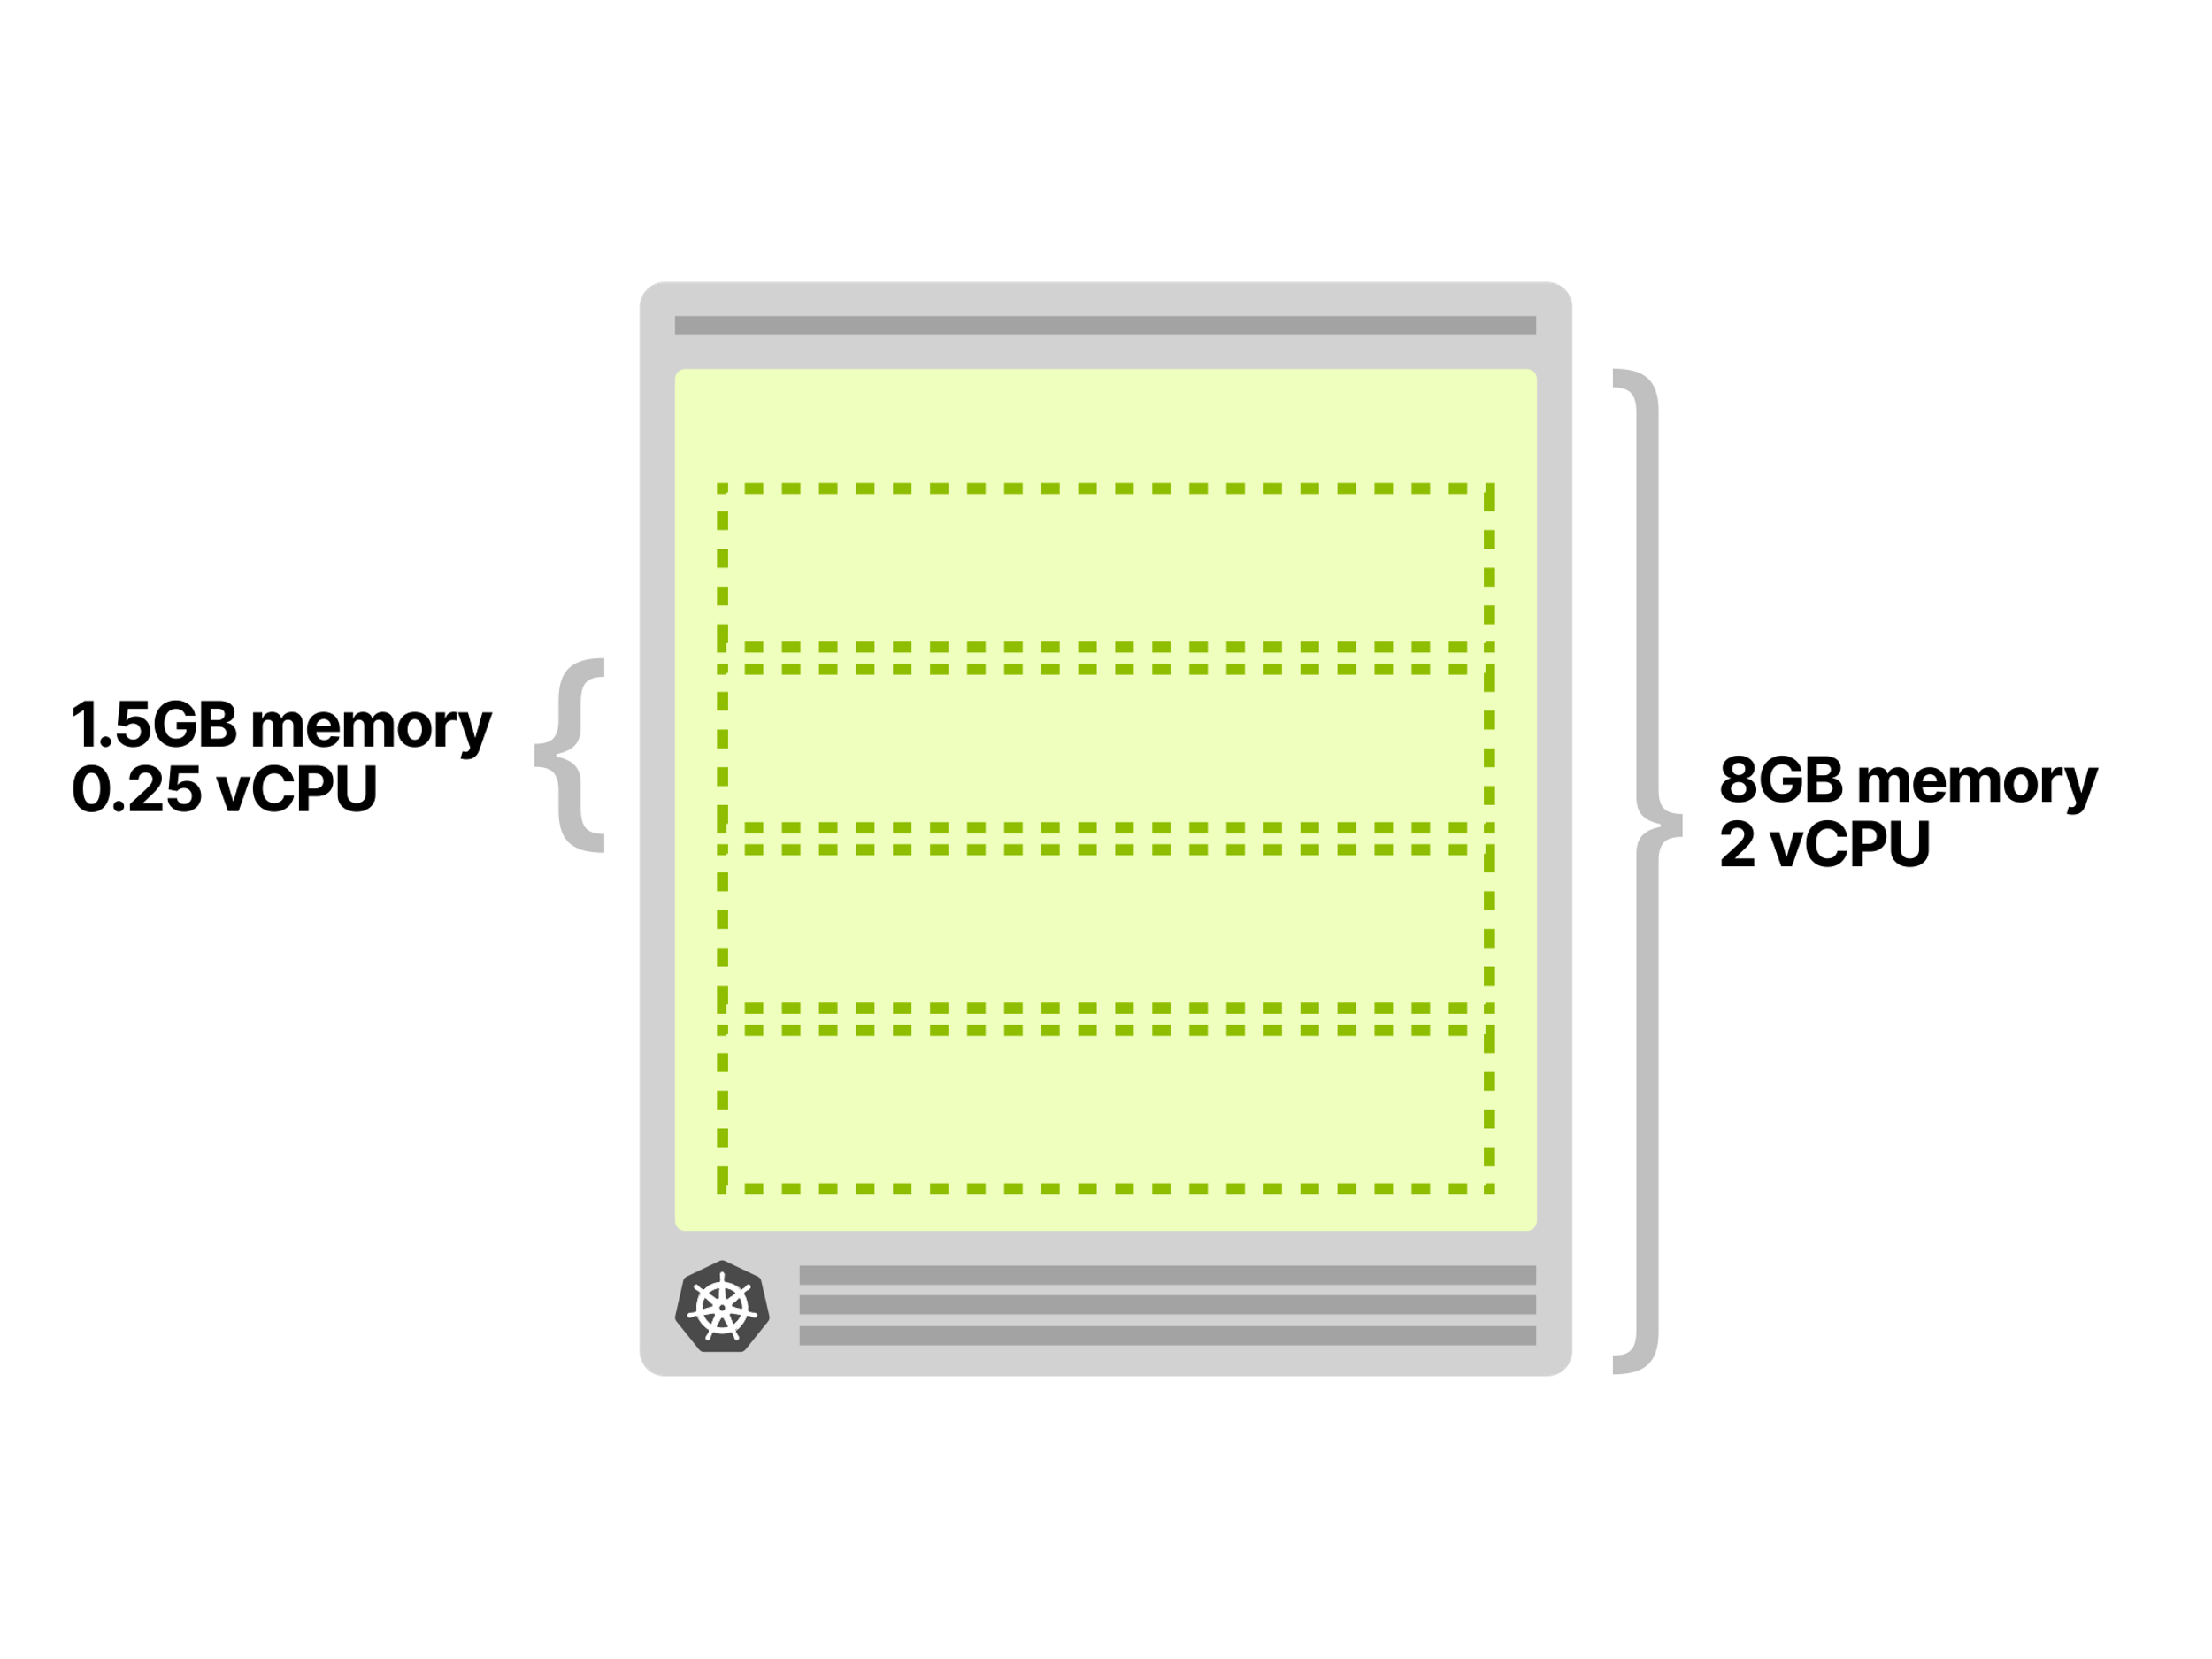
When autoscaling pods goes wrong
Imagine having an application that requires and uses 1.5GB of memory and 0.25 vCPU at all times.
You provisioned a cluster with a single node of 8GB and 2 vCPU — it should be able to fit four pods perfectly (and have a little bit of extra space left).

Slide 8
Then, you deploy a single Pod and set up:
An Horizontal Pod Autoscaler adds a replica every 10 incoming requests (i.e. if you have 40 concurrent requests, it should scale to 4 replicas).
A Cluster Autoscaler to create more nodes when resources are low.
NOTE: The HPA can scale the replicas in your deployment using Custom Metrics such as the queries per second (QPS) from an Ingress controller.

Slide 9

You start driving traffic 30 concurrent requests to your cluster and observe the following:
The Horizontal Pod Autoscaler starts scaling the Pods.
Two more Pods are created.
The Cluster Autoscaler doesn't trigger — no new node is created in the cluster.
It makes sense since there's enough space for one more Pod in that node.

Slide 10
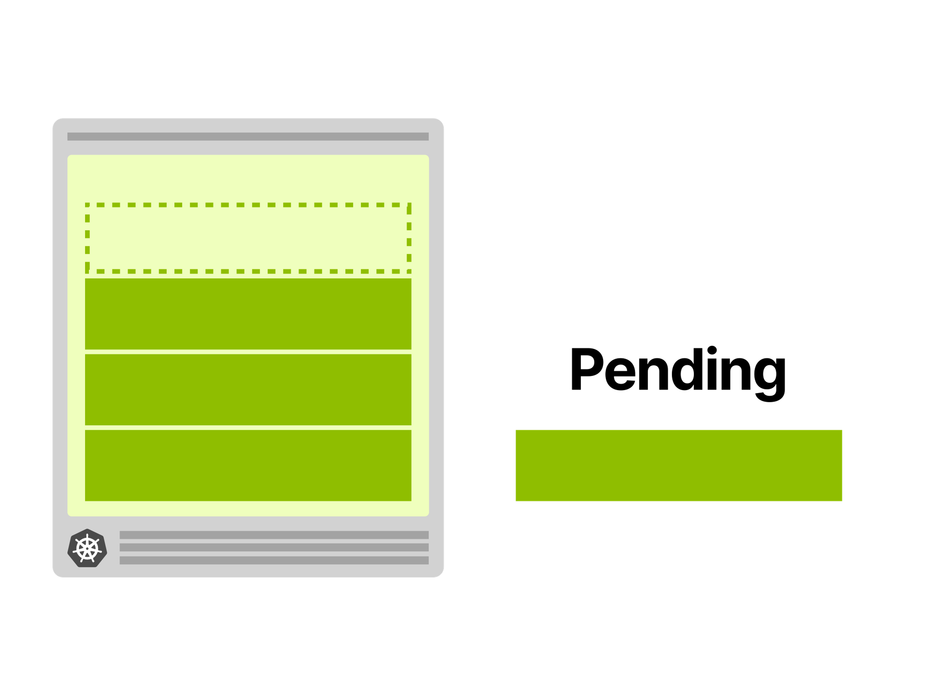

You further increase the traffic to 40 concurrent requests and observe again:
The Horizontal Pod Autoscaler creates one more Pod.
The Pod is pending and cannot be deployed.
The Cluster Autoscaler triggers creating a new node.
The node is provisioned in 4 minutes. After that, the pending Pod is deployed.
4 minutes …
When you scale to four replicas, the fourth replicas isn't deployed in the first node. Instead, it stays "Pending".
The autoscaler creates a new node, and the pod is finally deployed.

Slide 11
Why is the fourth Pod not deployed in the first node?
Pods deployed in your Kubernetes cluster consume resources such as memory, CPU and storage.
However, on the same node, the operating system and the kubelet require memory and CPU too.

Slide 12
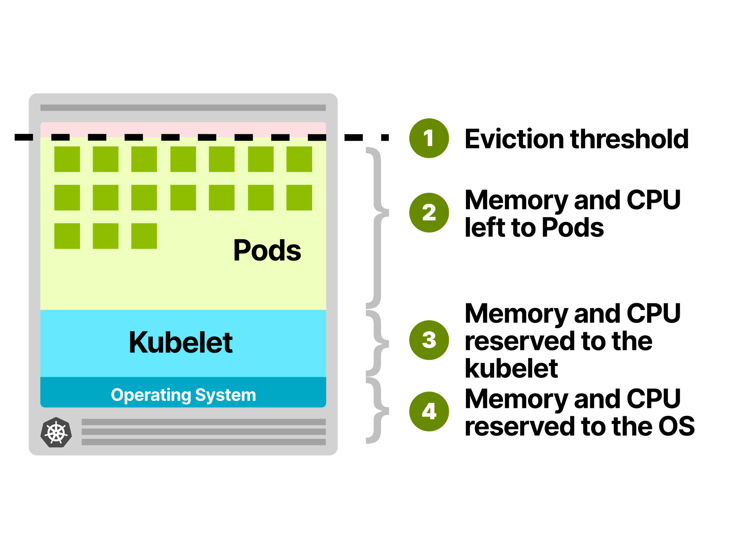
In a Kubernetes worker node's memory and CPU are divided into:
Resources reserved to the eviction threshold.
Resources available to Pods.
Resources necessary to run Kubernetes agents such as the Kubelet, the container runtime, node problem detector, etc.
Resources needed to run the operating system and system daemons such as SSH, systemd, etc.

Slide 13
All of those quotas are customisable, but you need to account for them!
In an 8GB and 2 vCPU virtual machine, you can expect:
100MB of memory and 0.1 vCPU to be reserved for the operating system.
1.8GB of memory and 0.07 vCPU to be reserved for the Kubelet.
100MB of memory for the eviction threshold.
The remaining ~6GB of memory and 1.83 vCPU are usable by the Pods.

Slide 14
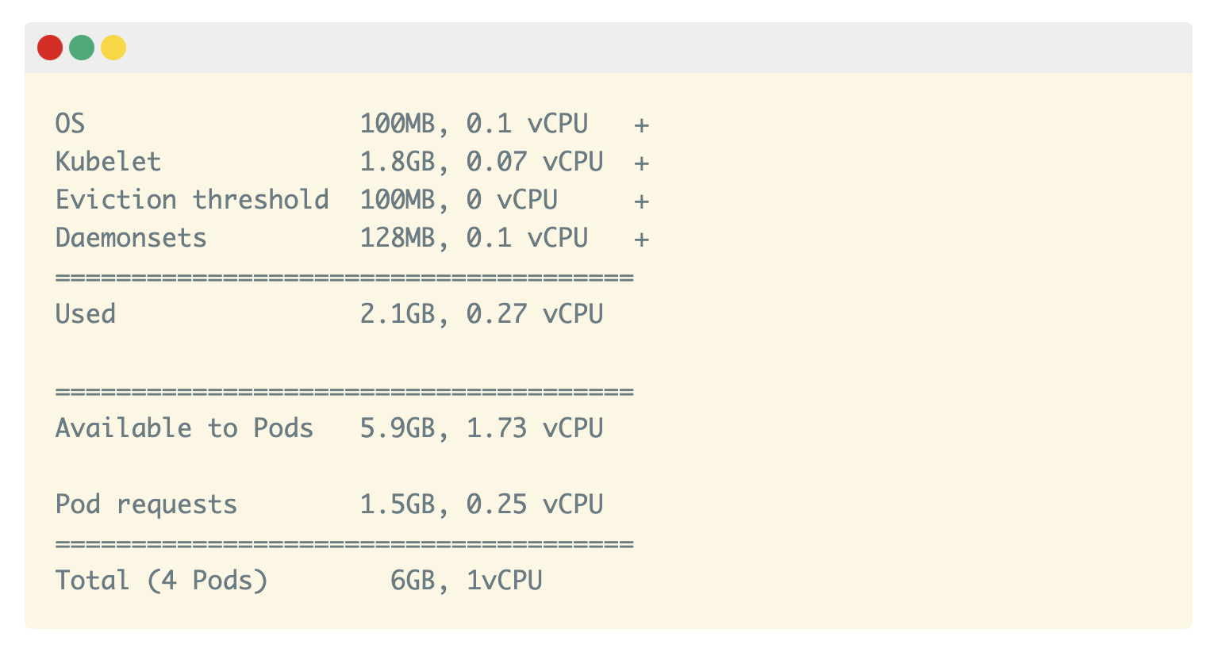
All of those quotas are customisable, but you need to account for them!
If your cluster runs a DeamonSet such as kube-proxy, you should further reduce the available memory and CPU.
Considering kube-proxy has requests of 128MB and 0.1 vCPU, only ~5.9GB of memory and 1.73 vCPU are available to run Pods.
After accounting for all the extra resources, you have space left for only three pods.

Slide 15
The fourth stays "Pending" unless it can be deployed on another node
Since the Cluster Autoscaler knows that there's no space for a fourth Pod, why doesn't it provision a new node?
Why does it wait for the Pod to be pending before it triggers creating a node?
4 minutes …
When you scale to four replicas, the fourth replicas isn't deployed in the first node. Instead, it stays "Pending".
The autoscaler creates a new node, and the pod is finally deployed.

Slide 16
How the Cluster Autoscaler works in Kubernetes?
The Cluster Autoscaler doesn't look at memory or CPU available when it triggers the autoscaling.
Instead, the Cluster Autoscaler reacts to events and checks for any unschedulable Pods every 10 seconds.
A pod is unschedulable when the scheduler is unable to find a node that can accommodate it.
For example, when a Pod requests 1 vCPU but the cluster has only 0.5 vCPU available, the scheduler marks the Pod as unschedulable.
That's when the Cluster Autoscaler initiates creating a new node.

Slide 17
How the Cluster Autoscaler works in Kubernetes? (cont’d)
The Cluster Autoscaler scans the current cluster and checks if any of the unschedulable pods would fit on in a new node.
If you have a cluster with several node types (often also referred to as node groups or node pools), the Cluster Autoscaler will pick one of them using the following strategies:
Random — picks a node type at random. This is the default strategy.
Most pods — selects the node group that would schedule the most pods.
Least waste — selects the node group with the least idle CPU after scale-up.
Price — select the node group that will cost the least (only works for GCP at the moment).
Priority — selects the node group with the highest priority (and you manually assign priorities).
Once the node type is identified, the Cluster Autoscaler will call the relevant API to provision a new compute resource.

Slide 18
How the Cluster Autoscaler works in Kubernetes? (cont’d)
If you're using AWS, the Cluster Autoscaler will provision a new EC2 instance.
On Azure, it will create a new Virtual Machine and on GCP, a new Compute Engine.
It may take some time before the created nodes appear in Kubernetes.
Unfortunately, provisioning new nodes is usually slow.
It might take several minutes to provision a new compute unit.

Slide 19
Exploring pod autoscaling lead time
The time it takes to create a new Pod on a new Node is determined by four major factors:
Horizontal Pod Autoscaler reaction time.
Cluster Autoscaler reaction time.
Node provisioning time.
Pod creation time.

Slide 20
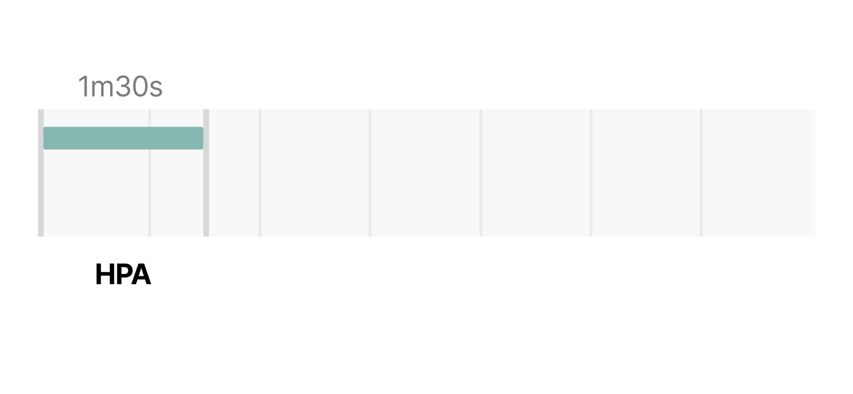
Horizontal Pod Autoscaler reaction time.
The Horizontal Pod Autoscaler controller is in charge of checking the metrics and deciding to scale up or down your replicas.
By default, the Horizontal Pod Autoscaler checks Pods metrics every 15 seconds.
Every minute, the Metrics Server will aggregate those metrics and expose them to the rest of the Kubernetes API.
By default, pods' CPU and memory usage is scraped by kubelet every 10 seconds.
In the worst-case scenario, the Horizontal Pod Autoscaler can take up to 1 minute and a half to trigger the autoscaling (i.e. 10s + 60s + 15s).

Slide 21
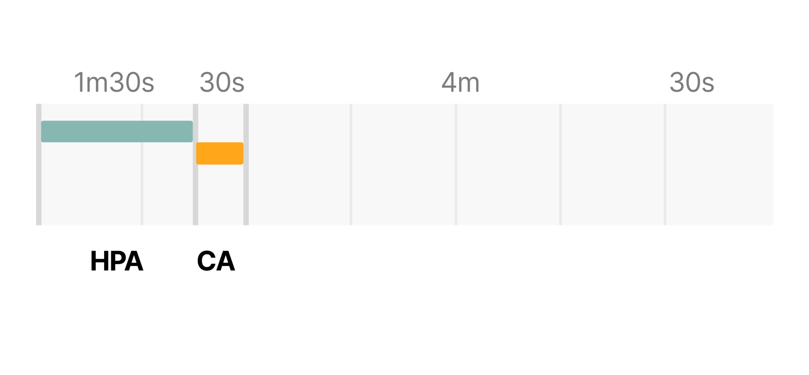
Cluster Autoscaler reaction time.
The Cluster Autoscaler checks for unschedulable Pods in the cluster every 10 seconds.
Once one or more Pods are detected, it will run an algorithm to decide:
How many nodes are necessary to deploy all pending Pods.
What type of node group should be created.
The entire process should take:
No more than 30 seconds on clusters with less than 100 nodes with up to 30 pods each. The average latency should be about 5 seconds.
No more than 60 seconds on cluster with 100 to 1000 nodes. The average latency should be about 15 seconds.

Slide 22
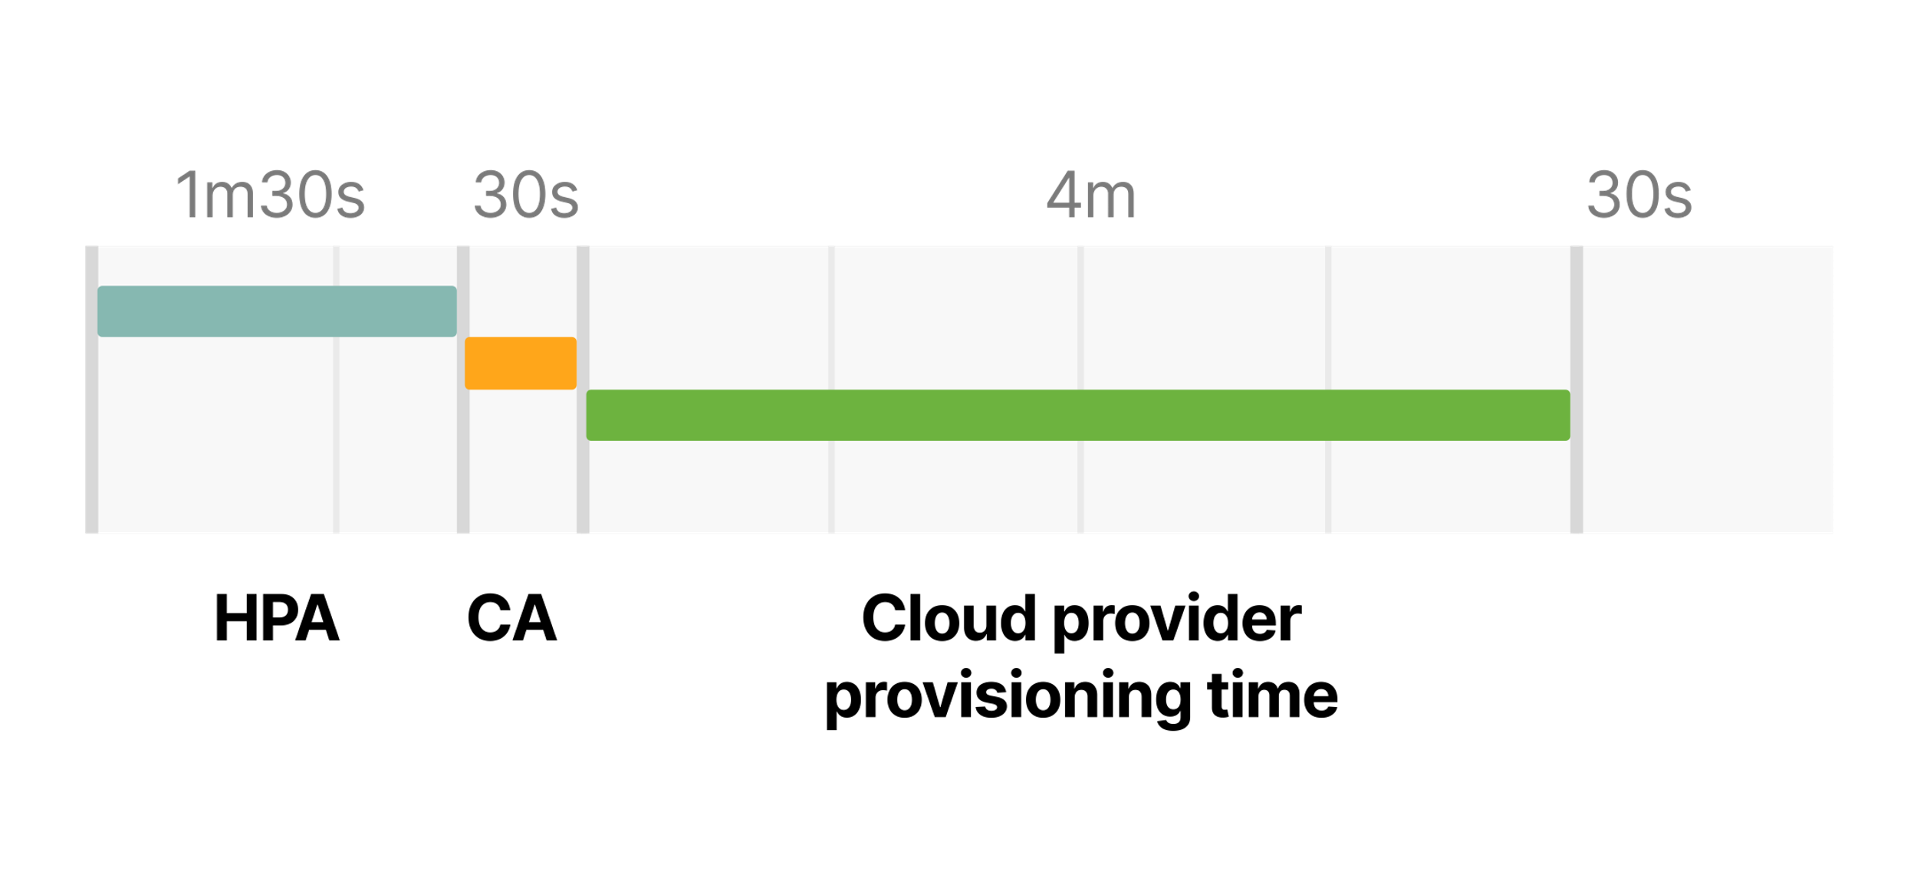
Node provisioning time.
It depends mainly on the cloud provider.
It's pretty standard for a new compute resource to be provisioned in 3 to 5 minutes.

Slide 23
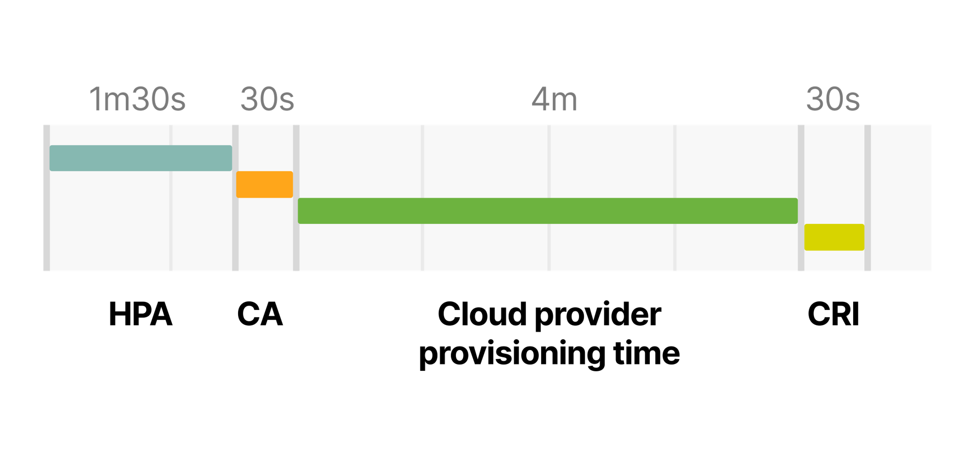
Pod creation time.
The Pod has to be created by the container runtime.
Launching a container shouldn't take more than few milliseconds, but downloading the container image could take several seconds.
If you're not caching your container images, downloading an image from the container registry could take from a couple of seconds up to a minute, depending on the size and number of layers.

Slide 24
So the total timing for trigger the autoscaling when there is no space in the current cluster is:
The Horizontal Pod Autoscaler might take up to 1m30s to increase the number of replicas.
The Cluster Autoscaler should take less than 30 seconds for a cluster with less than 100 nodes and less than a minute for a cluster with more than 100 nodes.
The cloud provider might take 3 to 5 minutes to create the computer resource.
The container runtime could take up to 30 seconds to download the container image.
In the worse case, with a small cluster, you have to wait 6m30s

Slide 25
With a cluster with more than 100 nodes…
The total delay could be up to 7 minutes!
Are you happy to wait for 7 minutes before you have more Pods to handle a sudden surge in traffic?
How can you tune the autoscaling to reduce the 7 minutes scaling time if you need a new node?

Slide 26
You could change…
The refresh time for the Horizontal Pod Autoscaler (controlled by the --horizontal-pod-autoscaler-sync-period flag, default is 15 seconds).
The interval for metrics scraping in the Metrics Server (controlled by the metric-resolution flag, default 60 seconds).
How frequently the cluster autoscaler scans for unscheduled Pods (controlled by the scan-interval flag, default 10 seconds).
How you cache the image on the local node (with a tool such as kube-fledged).
But even if you were to tune those settings to a tiny number, you will still be limited by the cloud provider provisioning time.

Slide 27
So, how could you fix that?
Since you can't change the provisioning time, you will need a workaround this time.
You could try two things:
Avoid creating new nodes, if possible.
Creating nodes proactively so that they are already provisioned when you need them.

Slide 28
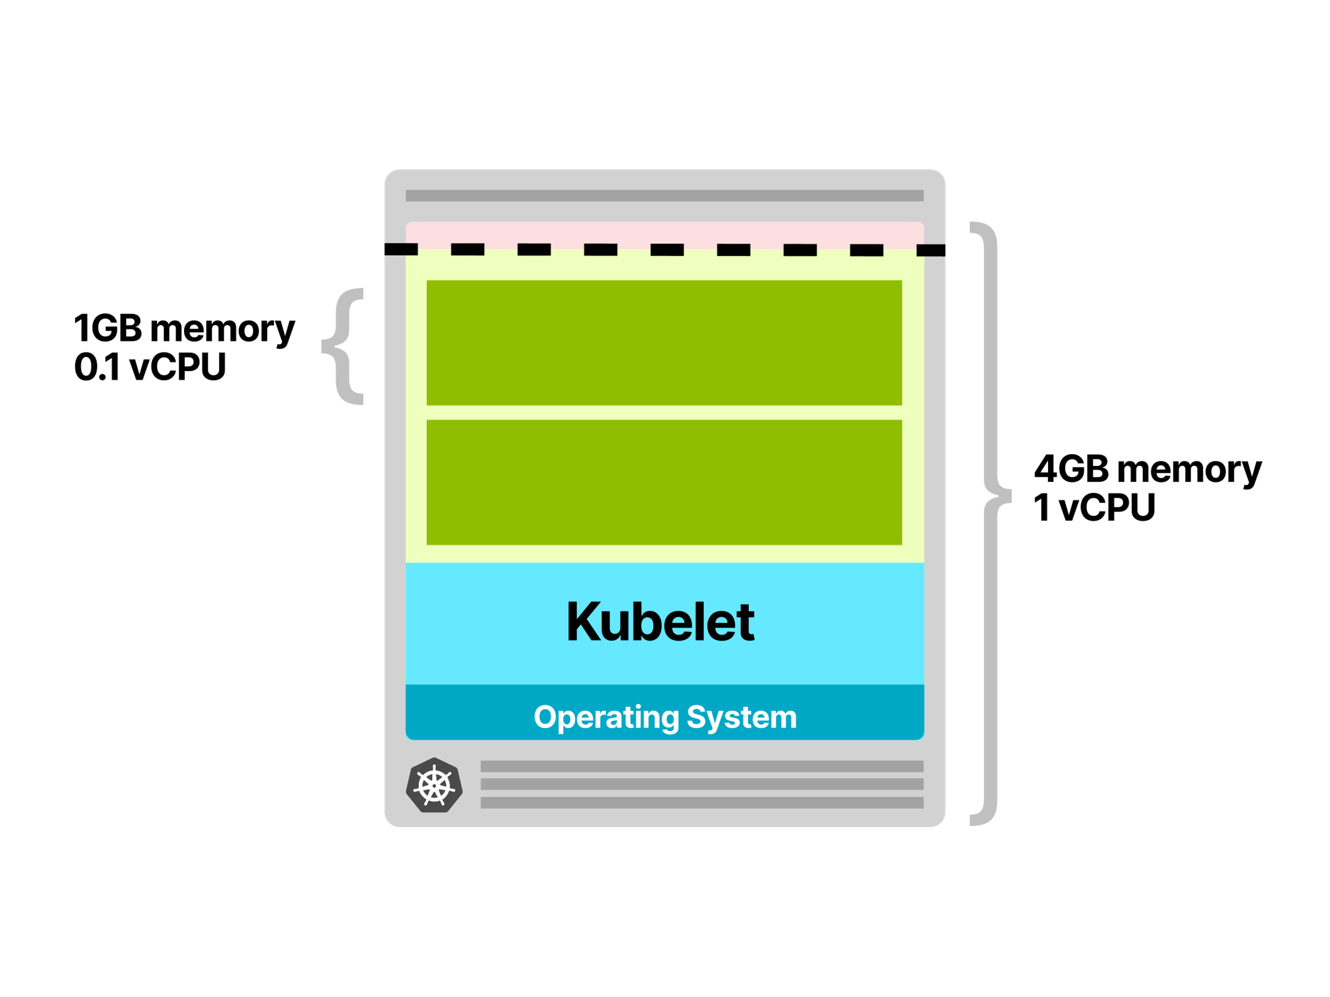
Avoid creating new nodes - Choosing the optimal instance size for a Kubernetes node
Choosing the right instance type for your cluster has dramatic consequences on your scaling strategy.
Consider the following scenario.
You have an application that requests 1GB of memory and 0.1 vCPU.
You provision a node that has 4GB of memory and 1 vCPU.
After reserving memory and CPU for the kubelet, operating system and eviction threshold, you are left with ~2.5GB of memory and 0.7 vCPU that can be used for running Pods.
Your node has space for only two Pods!
Every time you scale your replicas, you are likely to incur in up to 7 minutes delay (the lead time to trigger the Horizontal Pod Autoscaler, Cluster Autoscaler and provisioning the compute resource on the cloud provider).

Slide 29
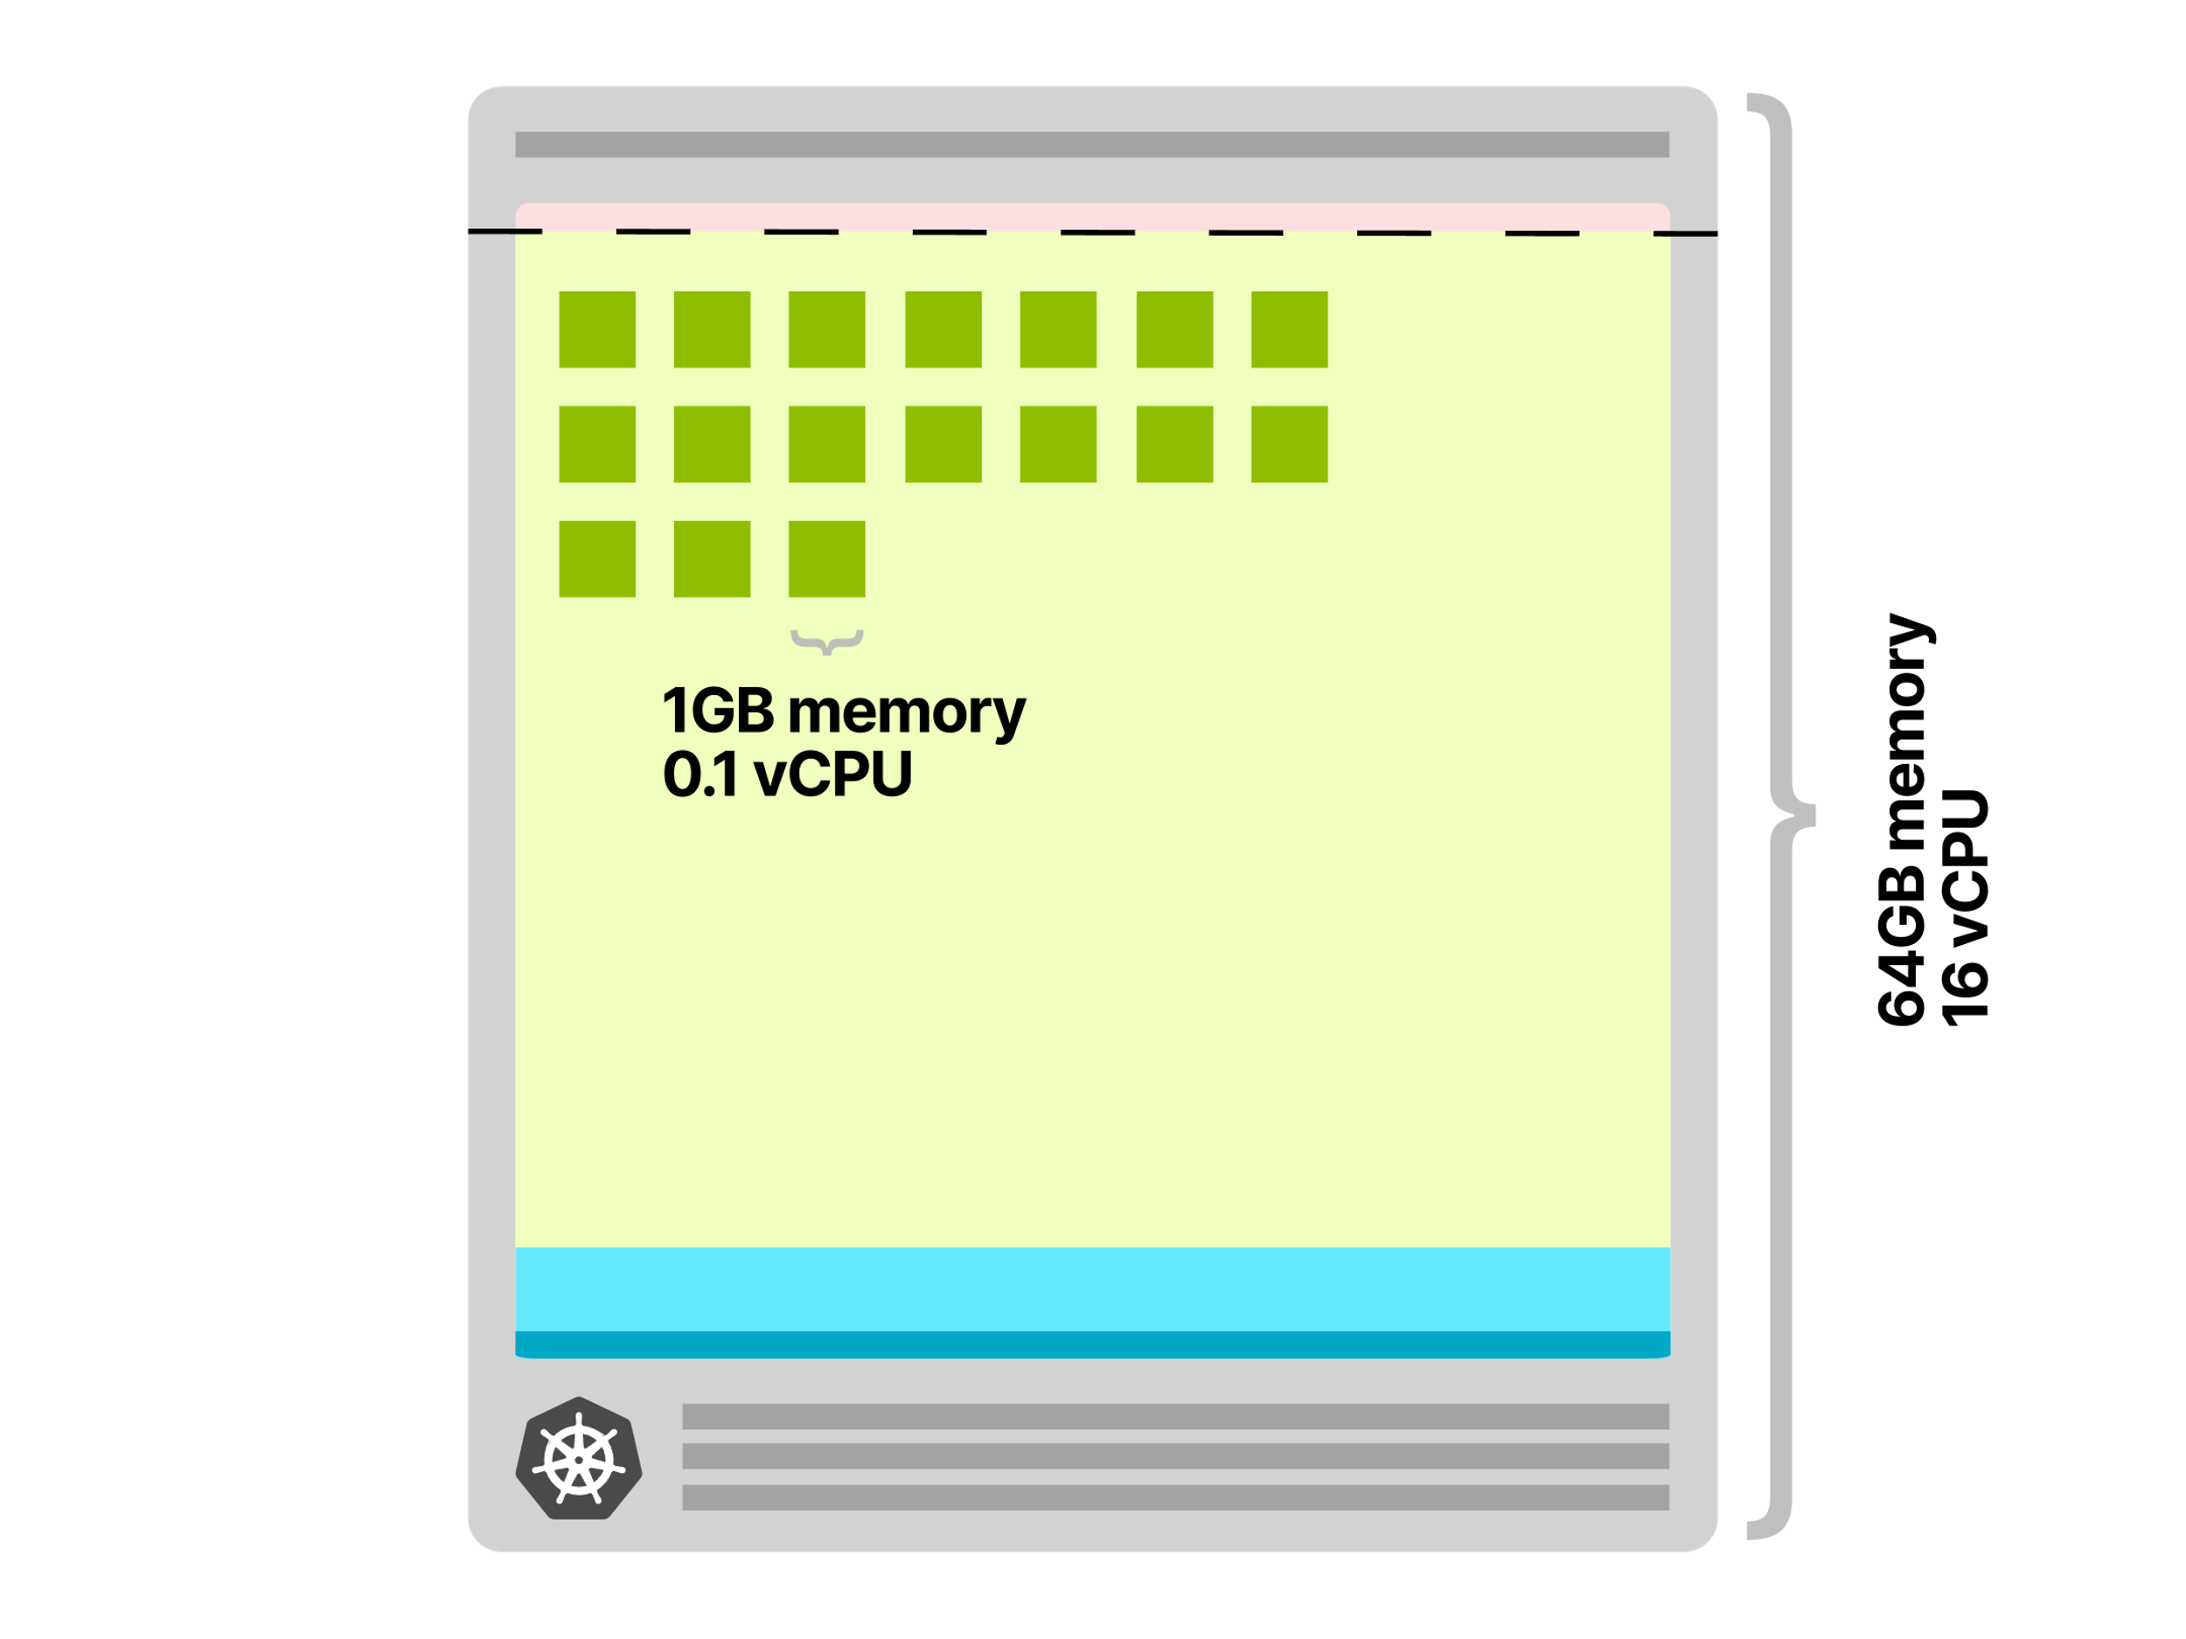
Let's have a look at what happens if you decide to use a 64GB memory and 16 vCPU node instead.
After reserving memory and CPU for the kubelet, operating system and eviction threshold
you are left with ~58.32GB of memory and 15.8 vCPU that can be used for running Pods.
The available space can host 58 Pods, and you are likely to need a new node only when you have more than 58 replicas.
Also, every time a node is added to the cluster, several pods can be deployed.
There is less chance to trigger again the Cluster Autoscaler (and provisioning new compute units on the cloud provider).

Slide 30
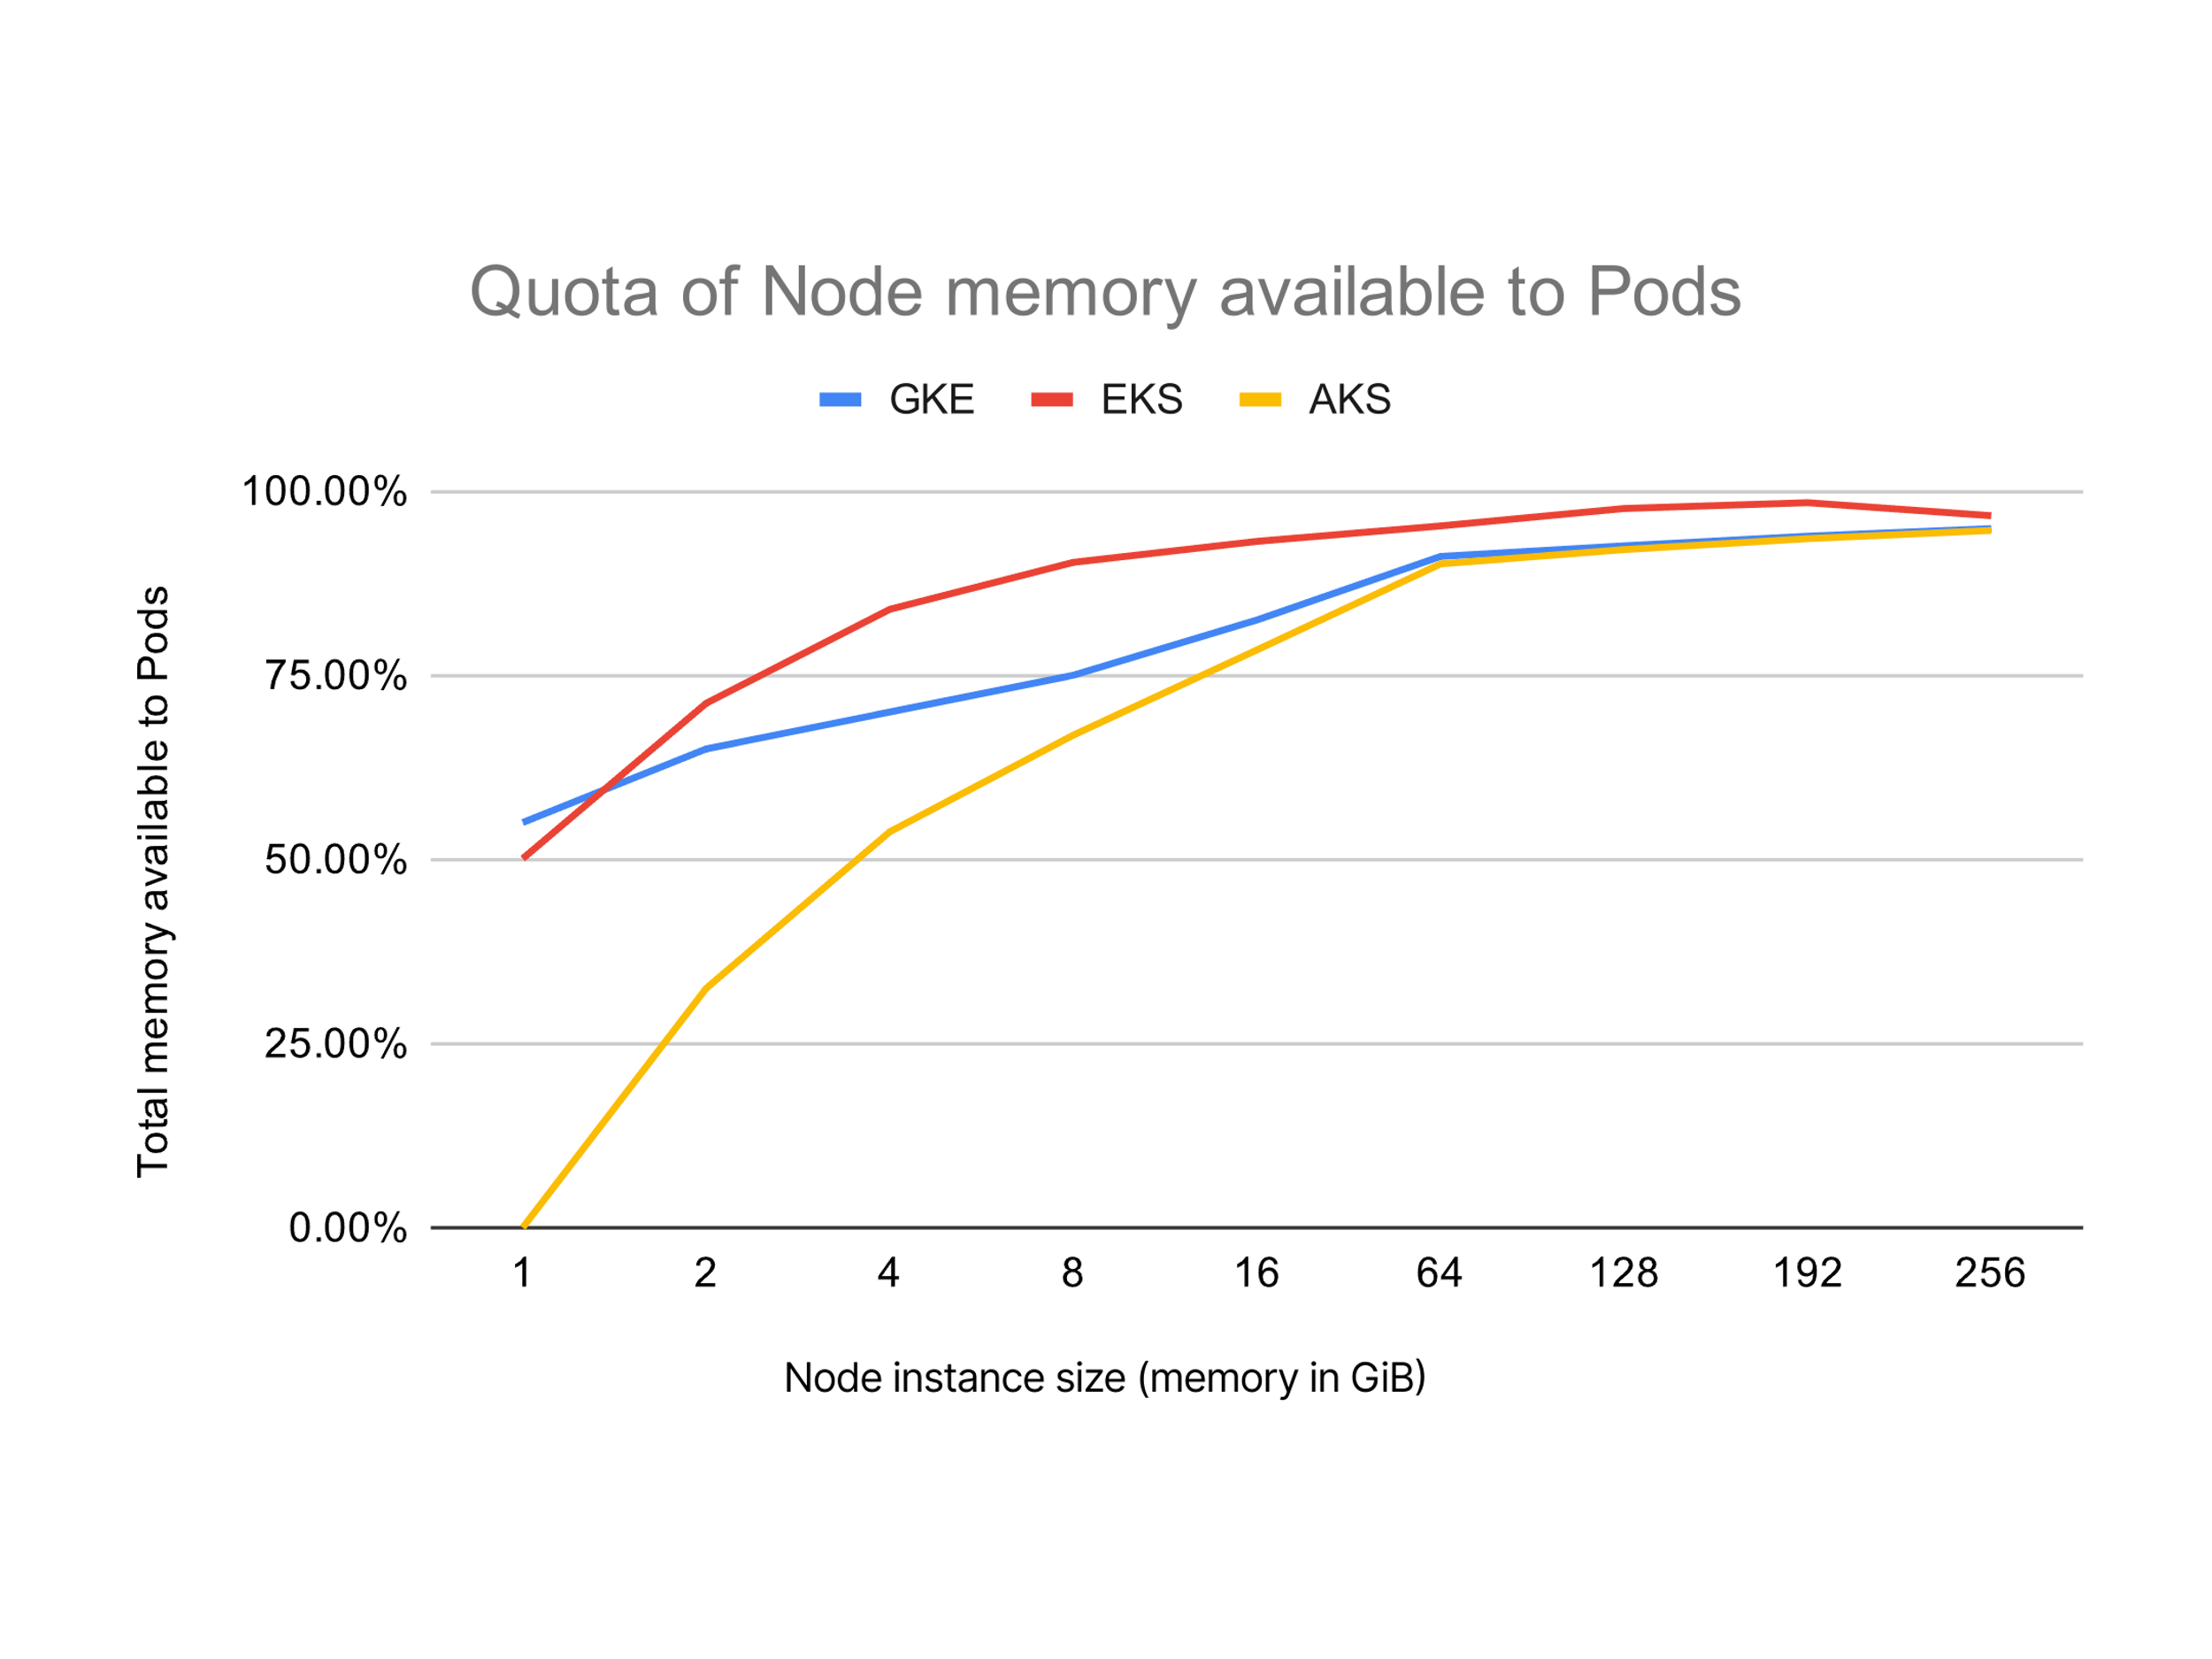
Choosing large instance types also has another benefit.
The ratio between resource reserved for Kubelet, operating system and eviction threshold and available resources to run Pods is greater.
Have a look at this graph that pictures the memory available to pods…
As the instance size increase, you can notice that (in proportion) the resources available to pods increase.
In other words, you are utilising your resources more efficiently than having two instances of half of the size.

Slide 31
Should you select the biggest instance all the time?
Choosing a larger instance type is not always a good option. You should also consider:
Blast radius — if you have only a few large nodes, then the impact of a failing node is bigger than if you have many small nodes.
Autoscaling is less cost-effective as the next increment is a (very) large node
You might still face a delay in provisioning the new LARGE compute unit.

Slide 32
How can you work around that?
What if instead of creating a new node when it's time to scale, you create the same node ahead of time?
Creating nodes proactively

Slide 33

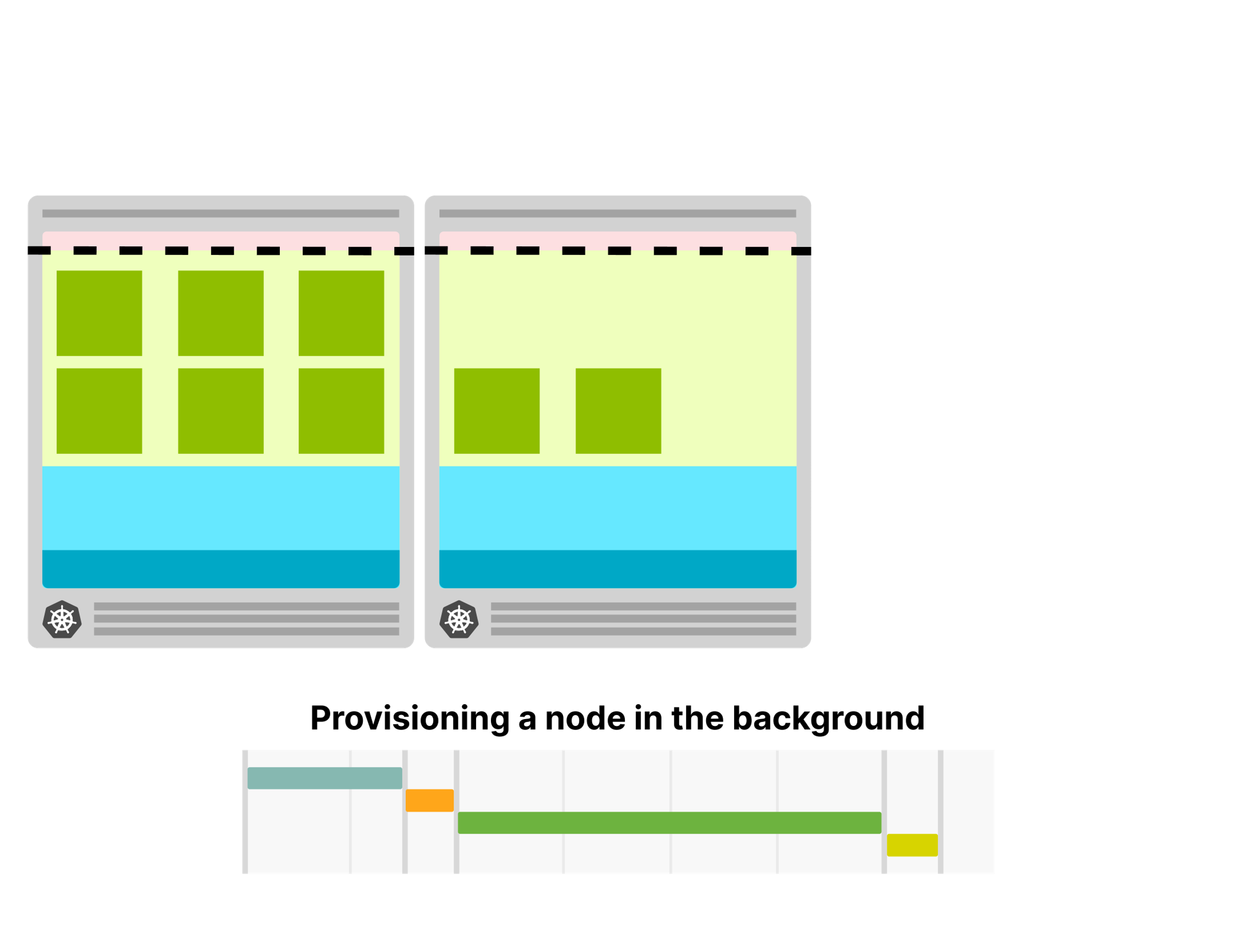

Overprovisioning nodes in your Kubernetes cluster
If you can afford to have a spare node available at all times, you could:
Create a node and leave it empty.
As soon as there's a Pod in the empty node, you create another empty node.
When you decide to overprovision a cluster, a node is always empty and ready to deploy Pods.
As soon as a Pod is created in the empty node, the Cluster Autoscaler creates a new node.
Since creating the Node happens in the background, you will likely not notice the lead time to provision a cloud machine.

Slide 34
It's a trade-off:
You incur an extra cost (one empty node available at all times), but you gain in speed.
With this strategy, you can scale your cluster much quicker. But there's bad and good news.
The bad news is that the Cluster Autoscaler doesn't have this functionality built-in.
It cannot be configured to be proactive, and there is no flag to "always provision an empty node".
The good news is that you can still fake (?) it.

Slide 35
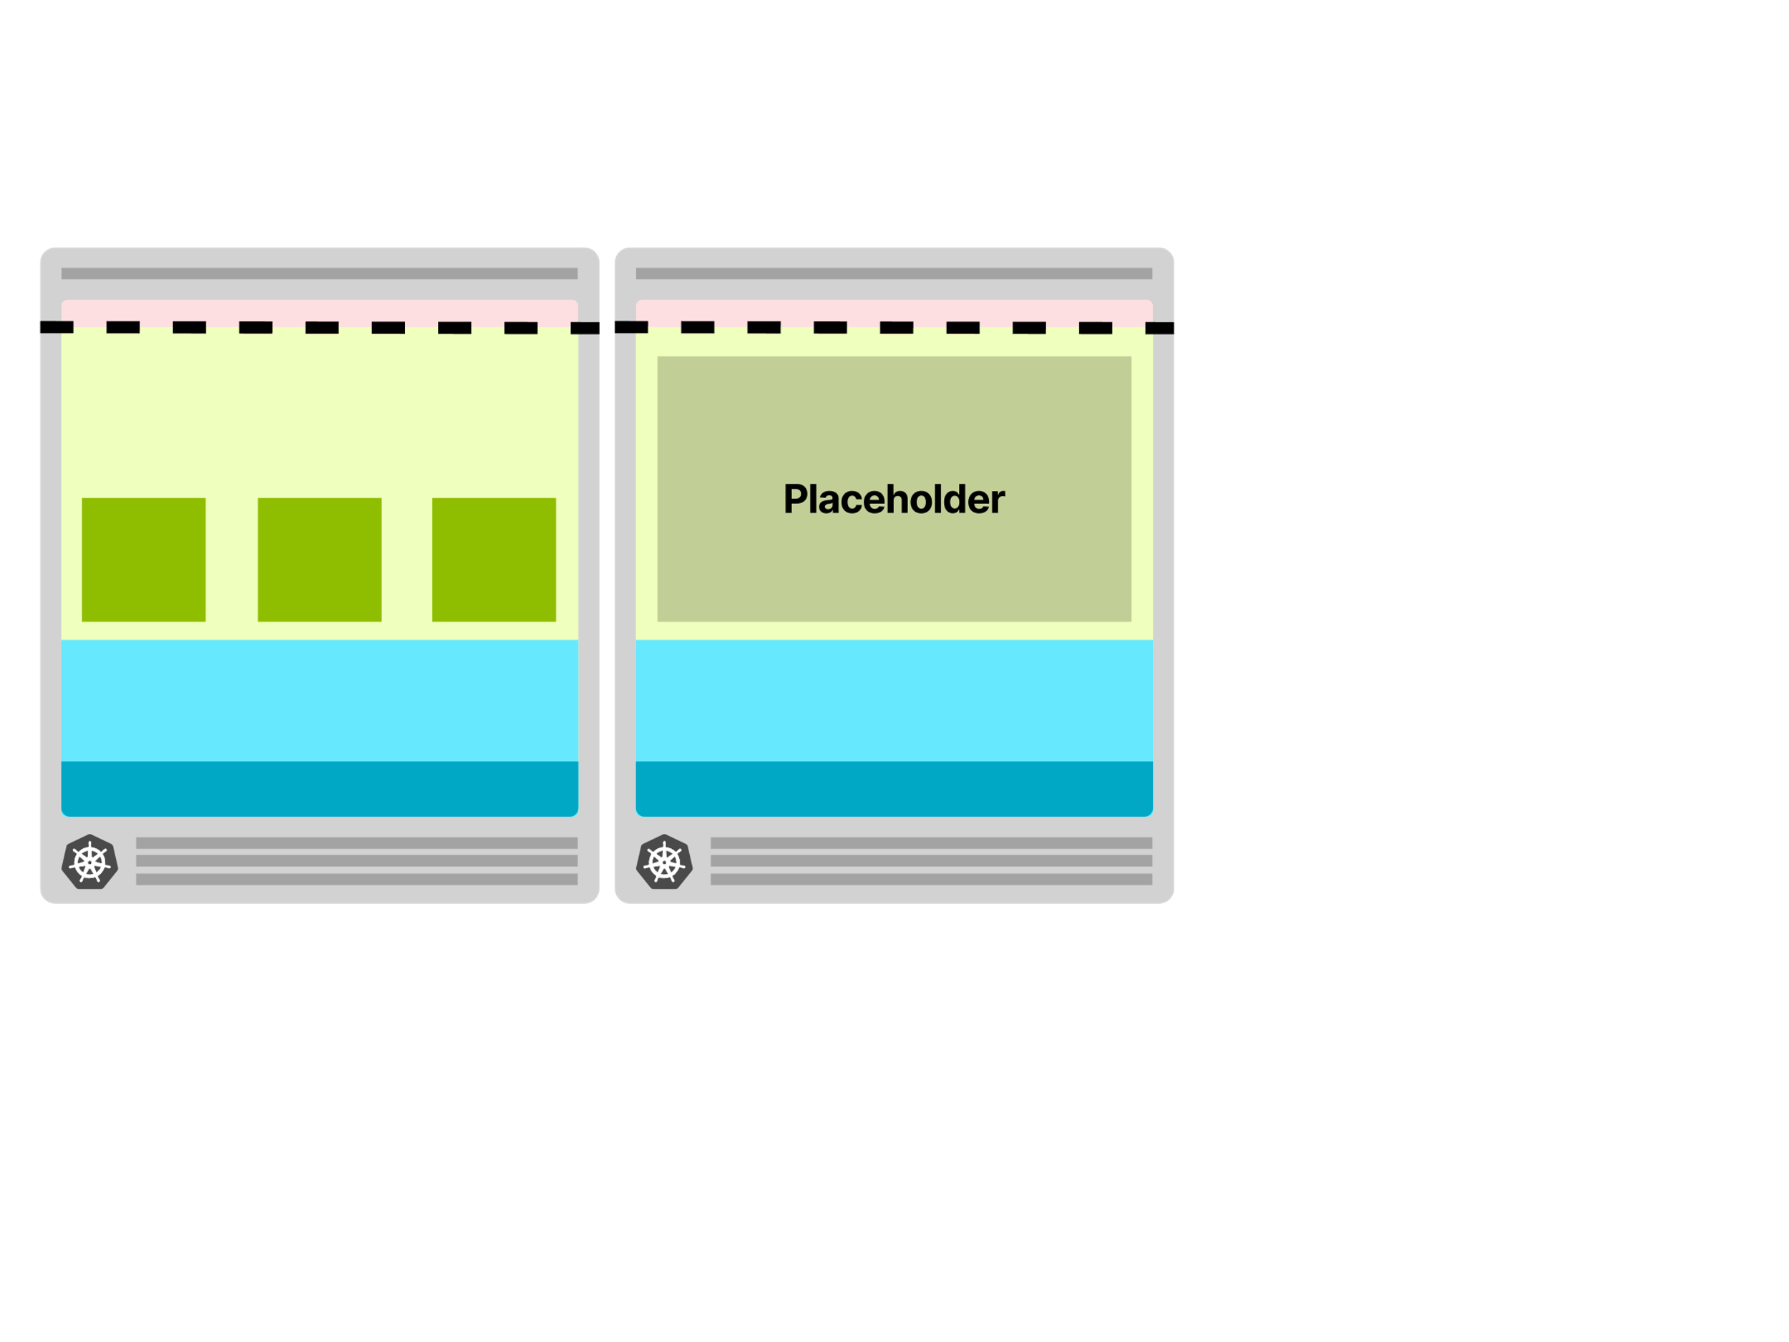
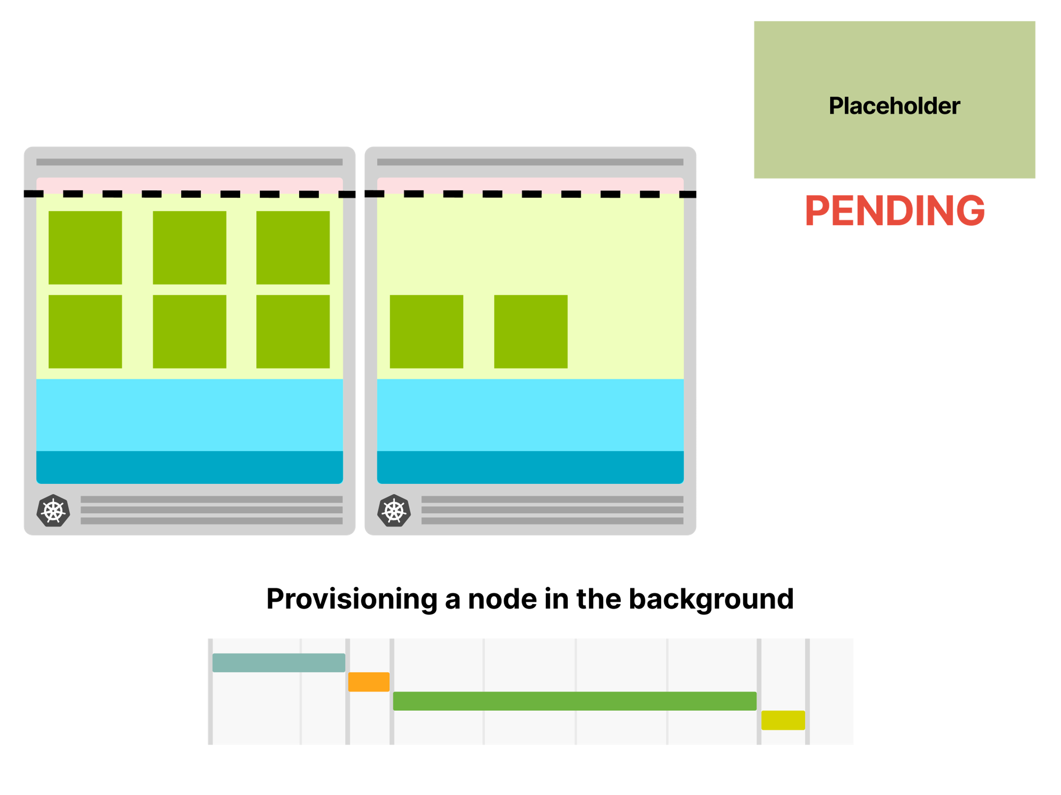
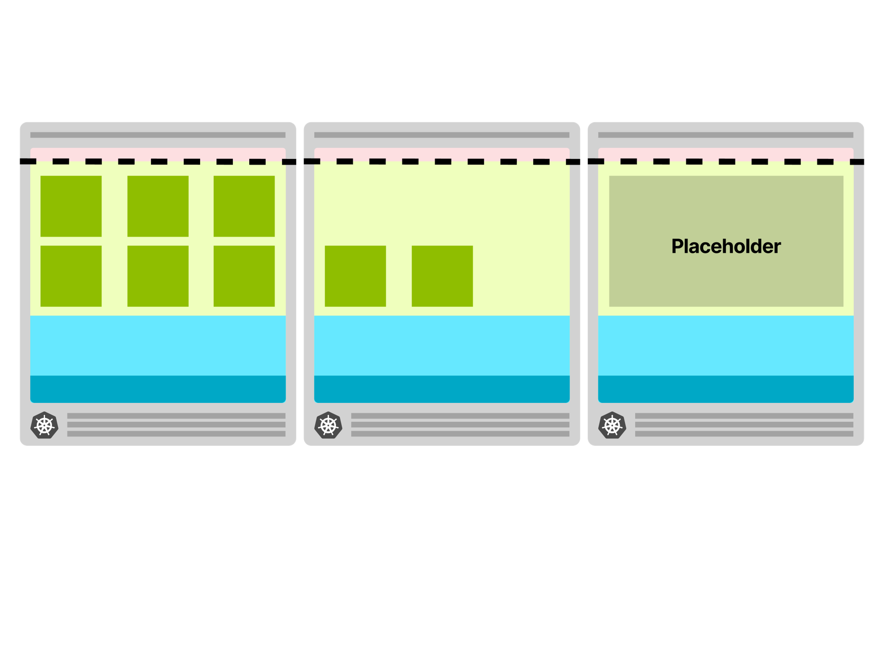
How to fake it?
You could run a “dummy” Pod with enough requested resources to reserve an entire node.
You could think about this Pod as a placeholder — it is meant to reserve space, not use any resource.
As soon as a real Pod is created, you could evict the placeholder Pod and deploy the real Pod.

Slide 36
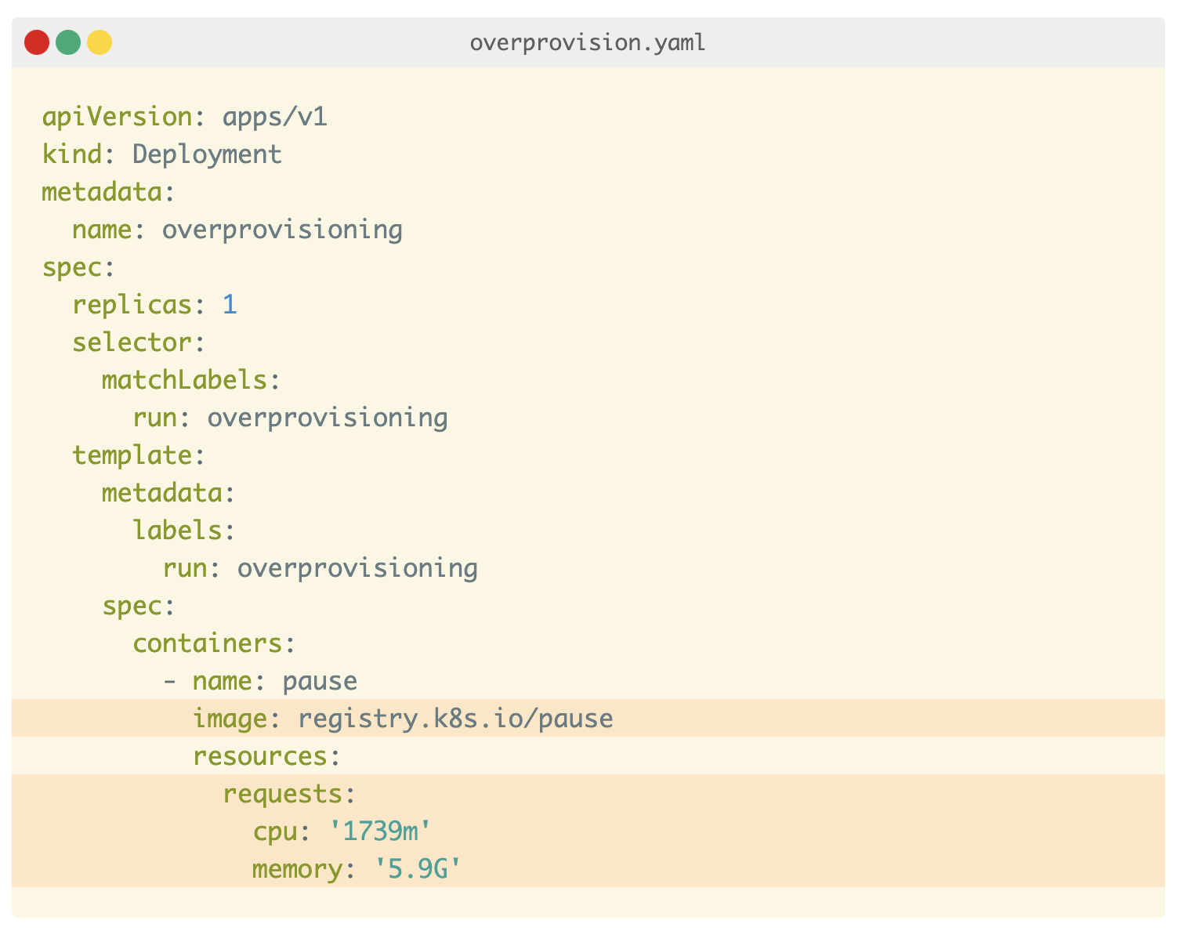
More details…
Overprovisioning can be configured using k8s deployment running a pod that sleeps forever.
You should pay extra attention to the memory and CPU requests.
The scheduler uses those values to decide where to deploy a Pod.
In this particular case, they are used to reserve the space.
You could provision a single large pod that has roughly the requests matching the available node resources.
Please make sure that you account for resources consumed by the kubelet, operating system, kube-proxy, etc. (Next)

Slide 37
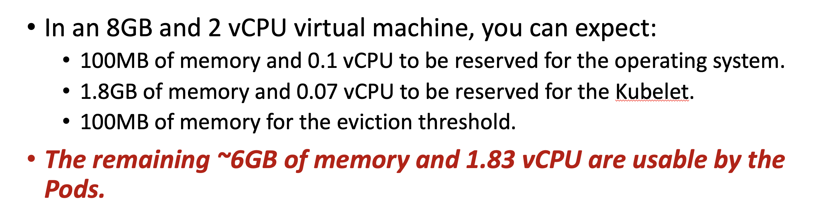
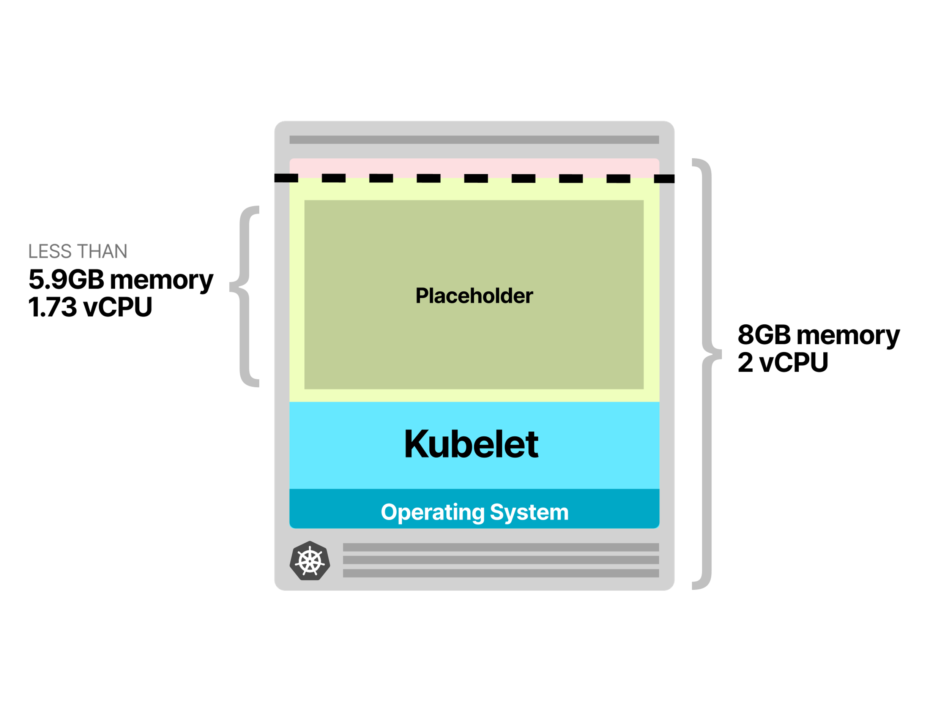
Example
If your node instance is 2 vCPU and 8GB of memory and the available space for pods is 1.73 vCPU and ~5.9GB of memory, your pause pod should match the latter.

Slide 38
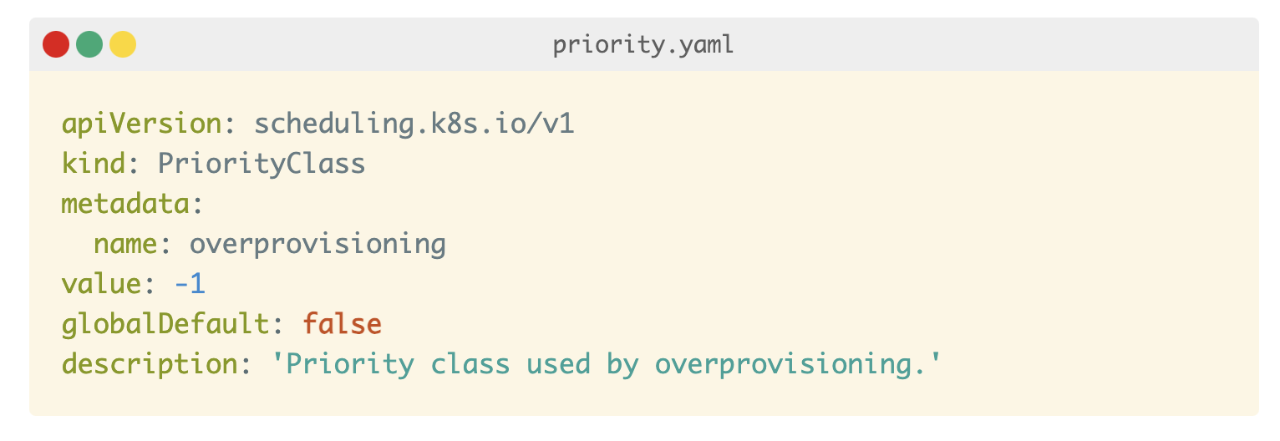
Pod Priority Class
Pod Priority indicates the importance of a Pod relative to other Pods.
To make sure that the placeholder Pod is evicted as soon as a real Pod is created, you can use Priorities and Preemptions.
When a Pod cannot be scheduled, the scheduler tries to preempt (evict) lower priority Pods to schedule the Pending pod.
You can configure Pod Priorities in your cluster with a PodPriorityClass:

Slide 39
Pod Priority Class
Since the default priority for a Pod is 0 and the overprovisioning PriorityClass has a value of -1, those Pods tagged with “overprovisioning” PriorityClass are the first to be evicted when the cluster runs out of space.
PriorityClass also has two optional fields: globalDefault and description.
The globalDefault field indicates that the value of this PriorityClass should be used for Pods without a priorityClassName. Only one PriorityClass with globalDefault set to true can exist in the system.
The description is a human-readable memo of what the PriorityClass is about.

Slide 40
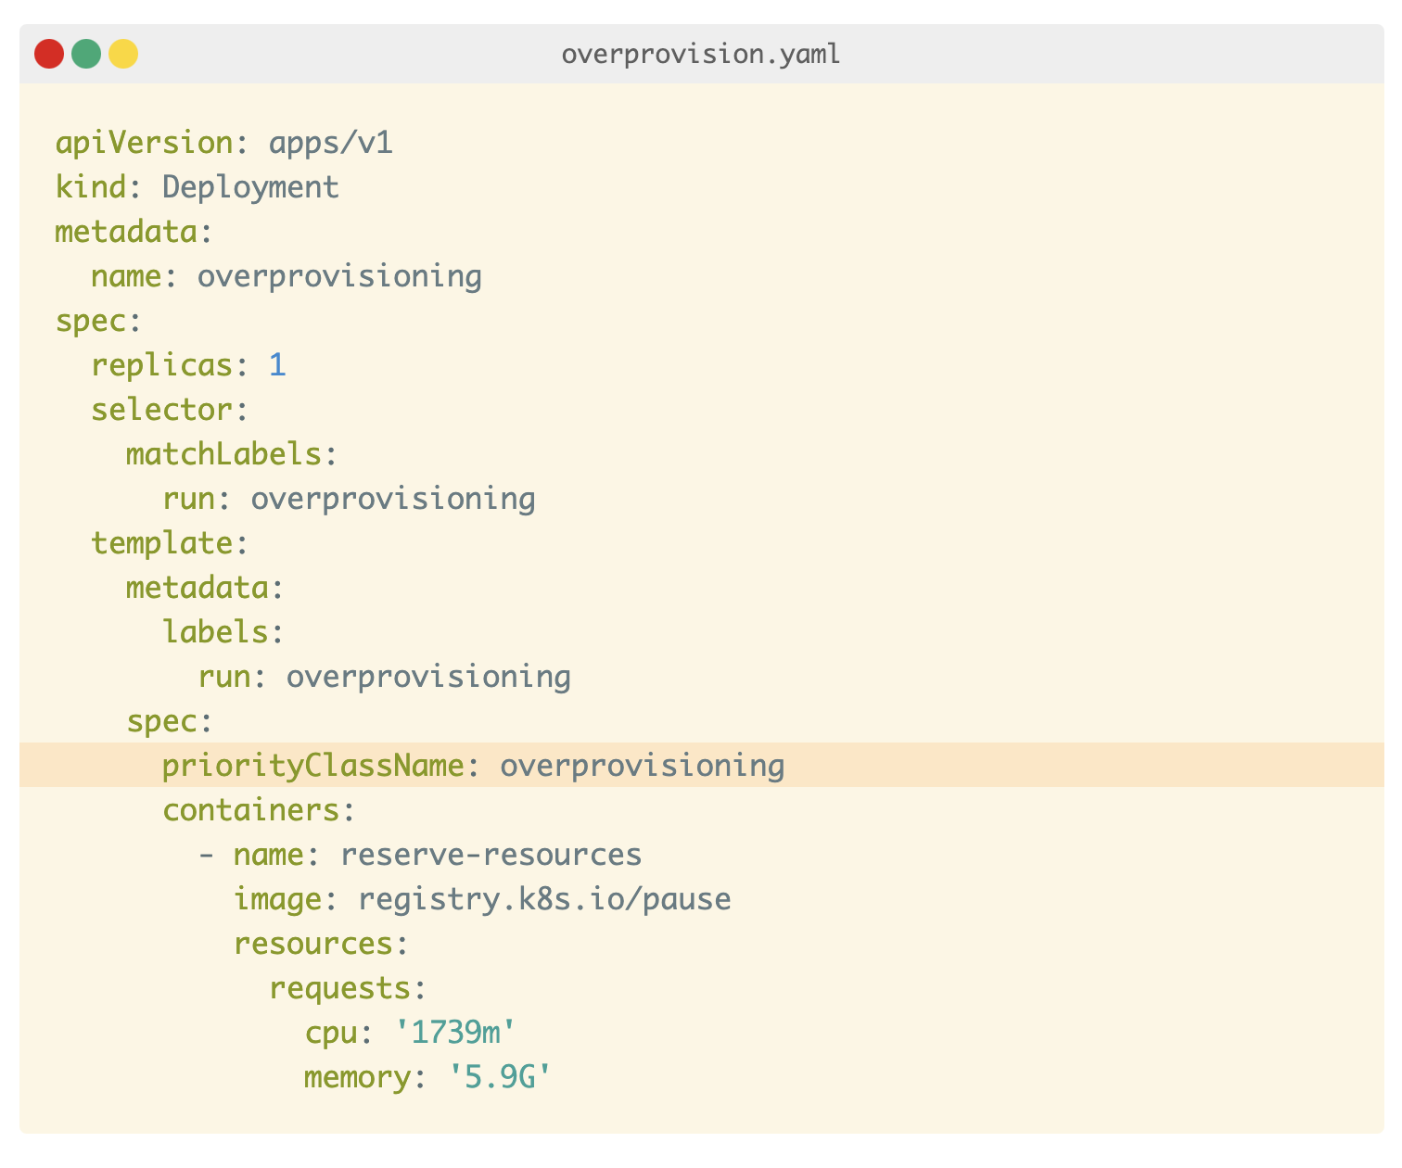
How to assign the priority to the Pod?
You can assign the priority to your sleep Pod with:
When there are not enough resources in the cluster, the placeholder pod is preempted right away, and new pods take their place.
Since the placeholder pod become unschedulable, it forces the Cluster Autoscaler to add more nodes to the cluster.

Slide 41
How to downscale a cluster?
Every 10 seconds (default value), the Cluster Autoscaler decides to remove a node only when the request utilization falls below 50%.
Note: Cluster Autoscaler only looks at requested resource of pods instead of actual CPU and memory usage (obtained from top, meminfo)
Graceful termination of the node
Mark nodes as unschedulable
Move the running pods to another node; or wait for all pods to terminate

Slide 42
Vertical Autoscaling: Selecting the correct memory and CPU requests for your Pods
The cluster autoscaler makes scaling decisions based on the presence of pending pods (“unschedulable”).
The Kubernetes scheduler places a Pod to a Node based on its memory and CPU requests.
Hence, it's essential to set the correct requests on your pods, or you might be triggering your cluster autoscaler too late (or too early).

Slide 43
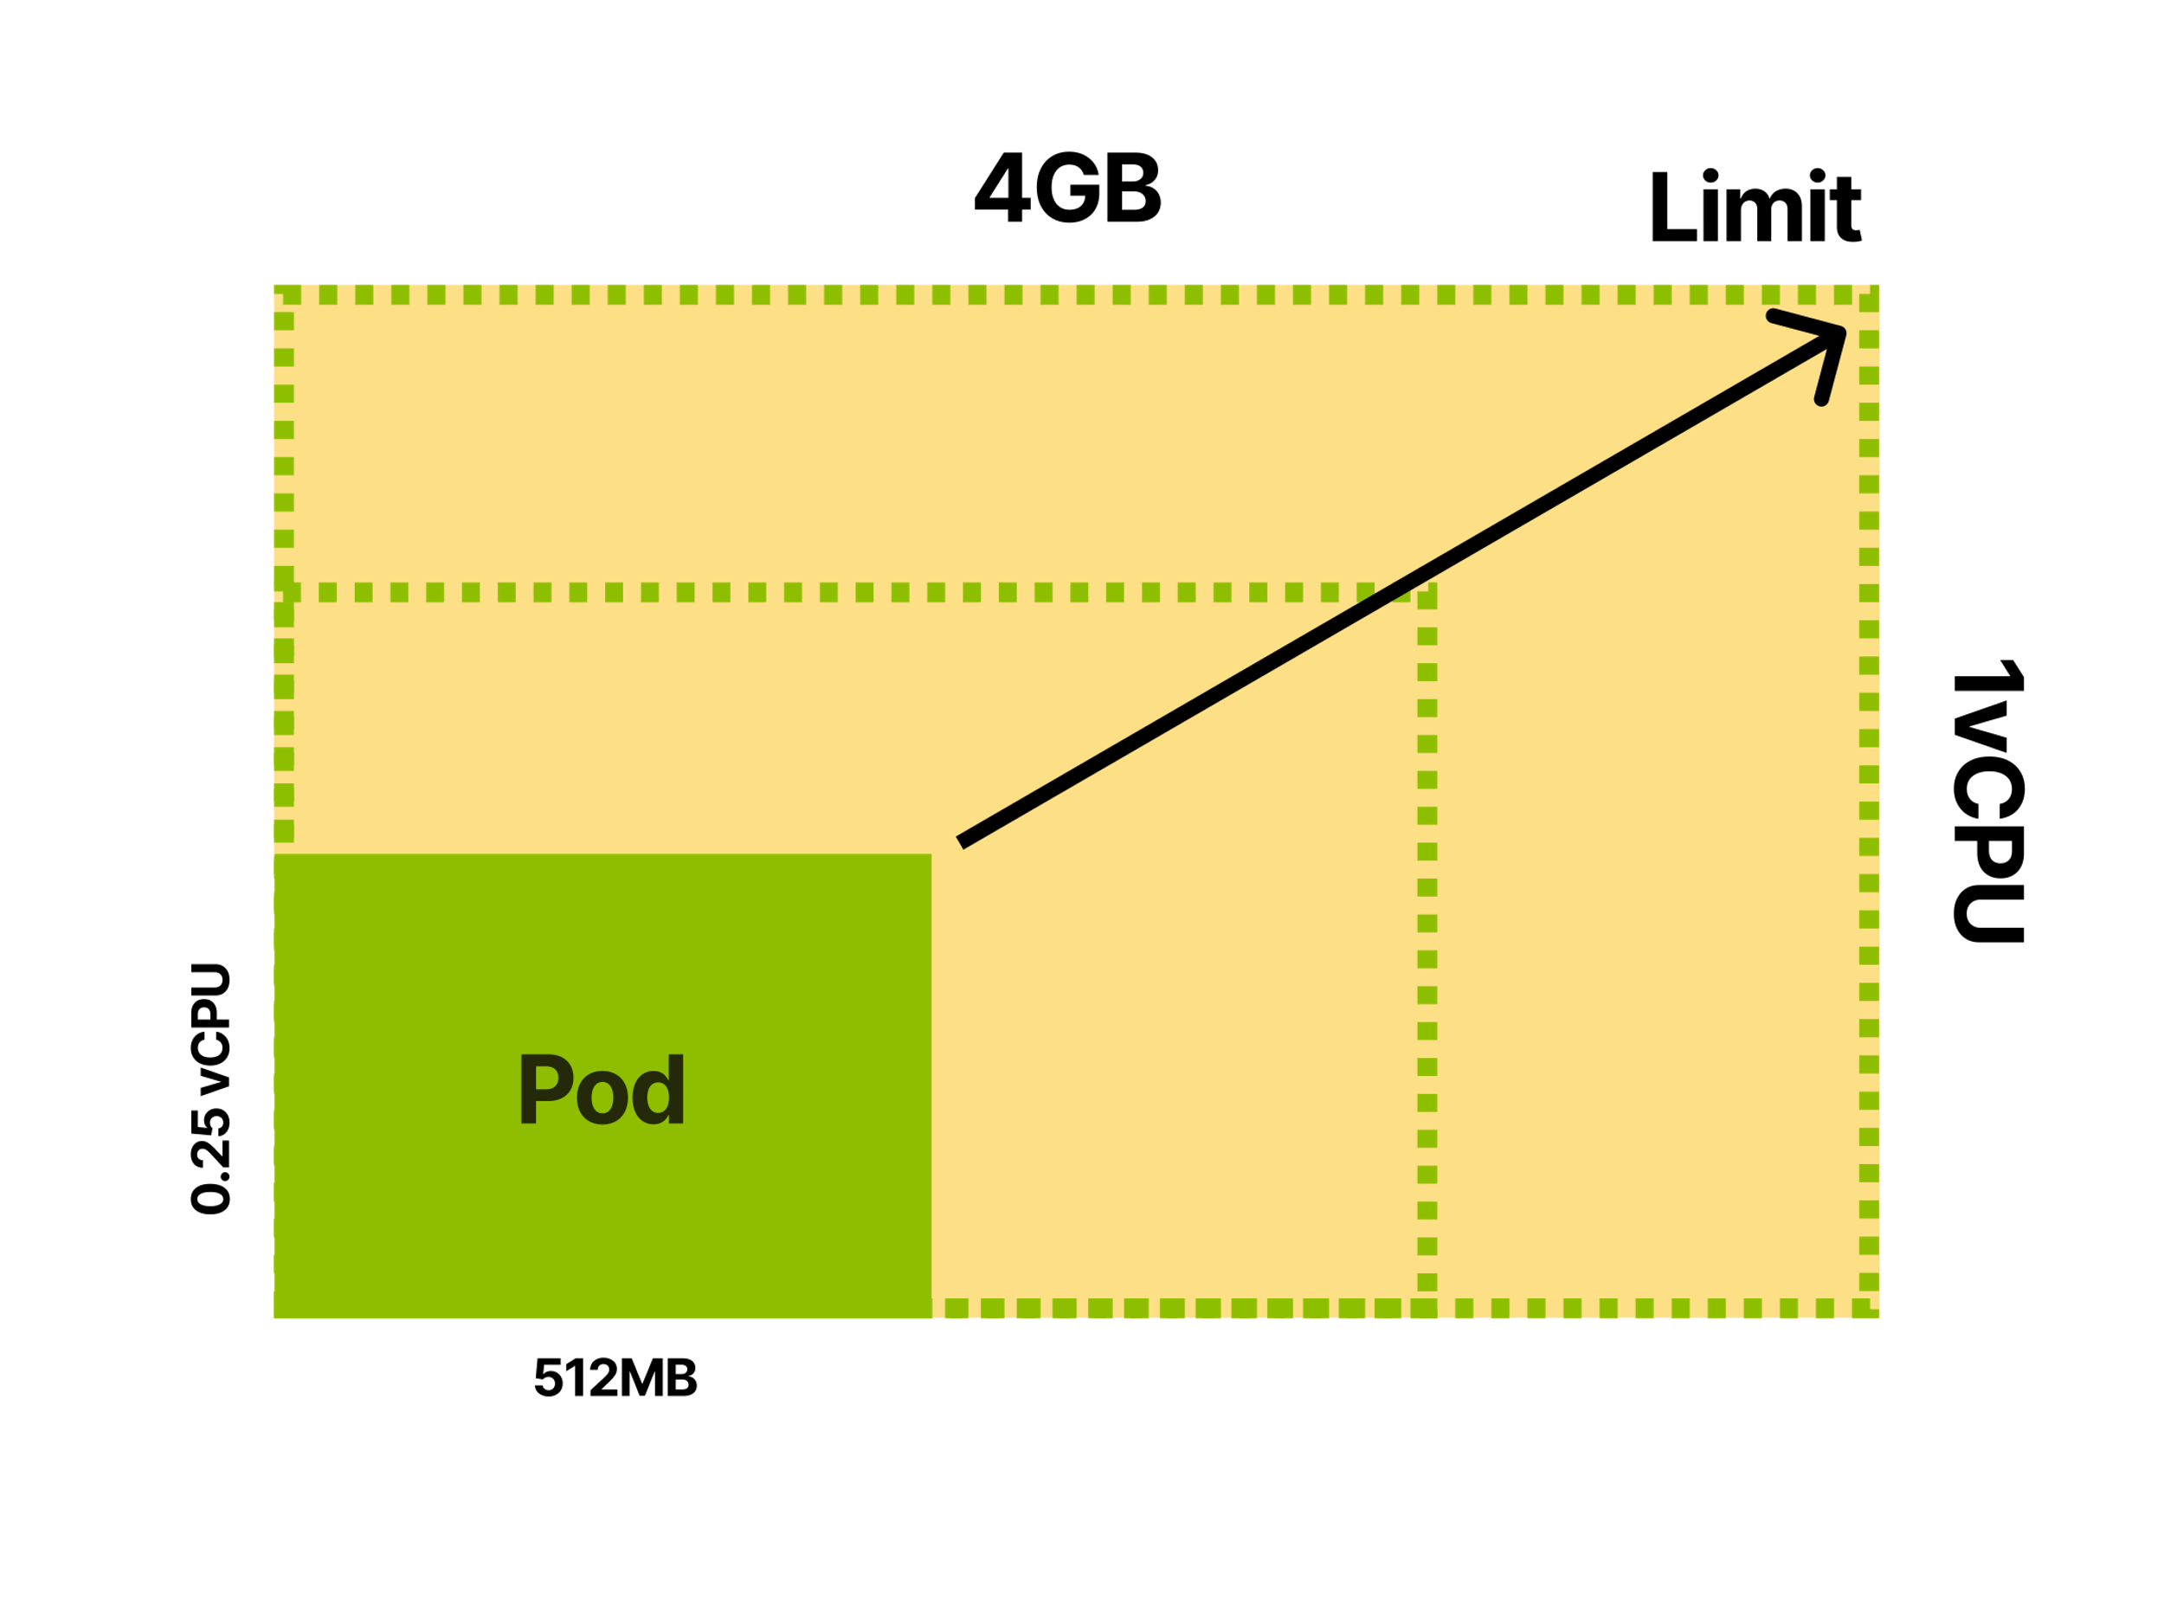
Selecting the correct memory and CPU requests for your Pods (cont’d)
Let's have a look at an example.
You decide to profile your application pod, and you found out that:
Under average load, the pod consumes 512MB of memory and 0.25 vCPU.
At peak, the pod should consume up to 4GB of memory and 1 vCPU.
The limit for your container is 4GB of memory and 1 vCPU.

Slide 44
Selecting the correct memory and CPU requests for your Pods (cont’d)
How should we set the CPU and memory requests for your pods?
We have three options:
Set requests lower than the actual average usage.
Set requests to match the actual limits.
Be conservative and assign requests closer to the limit.
Which option we should use?

Slide 45
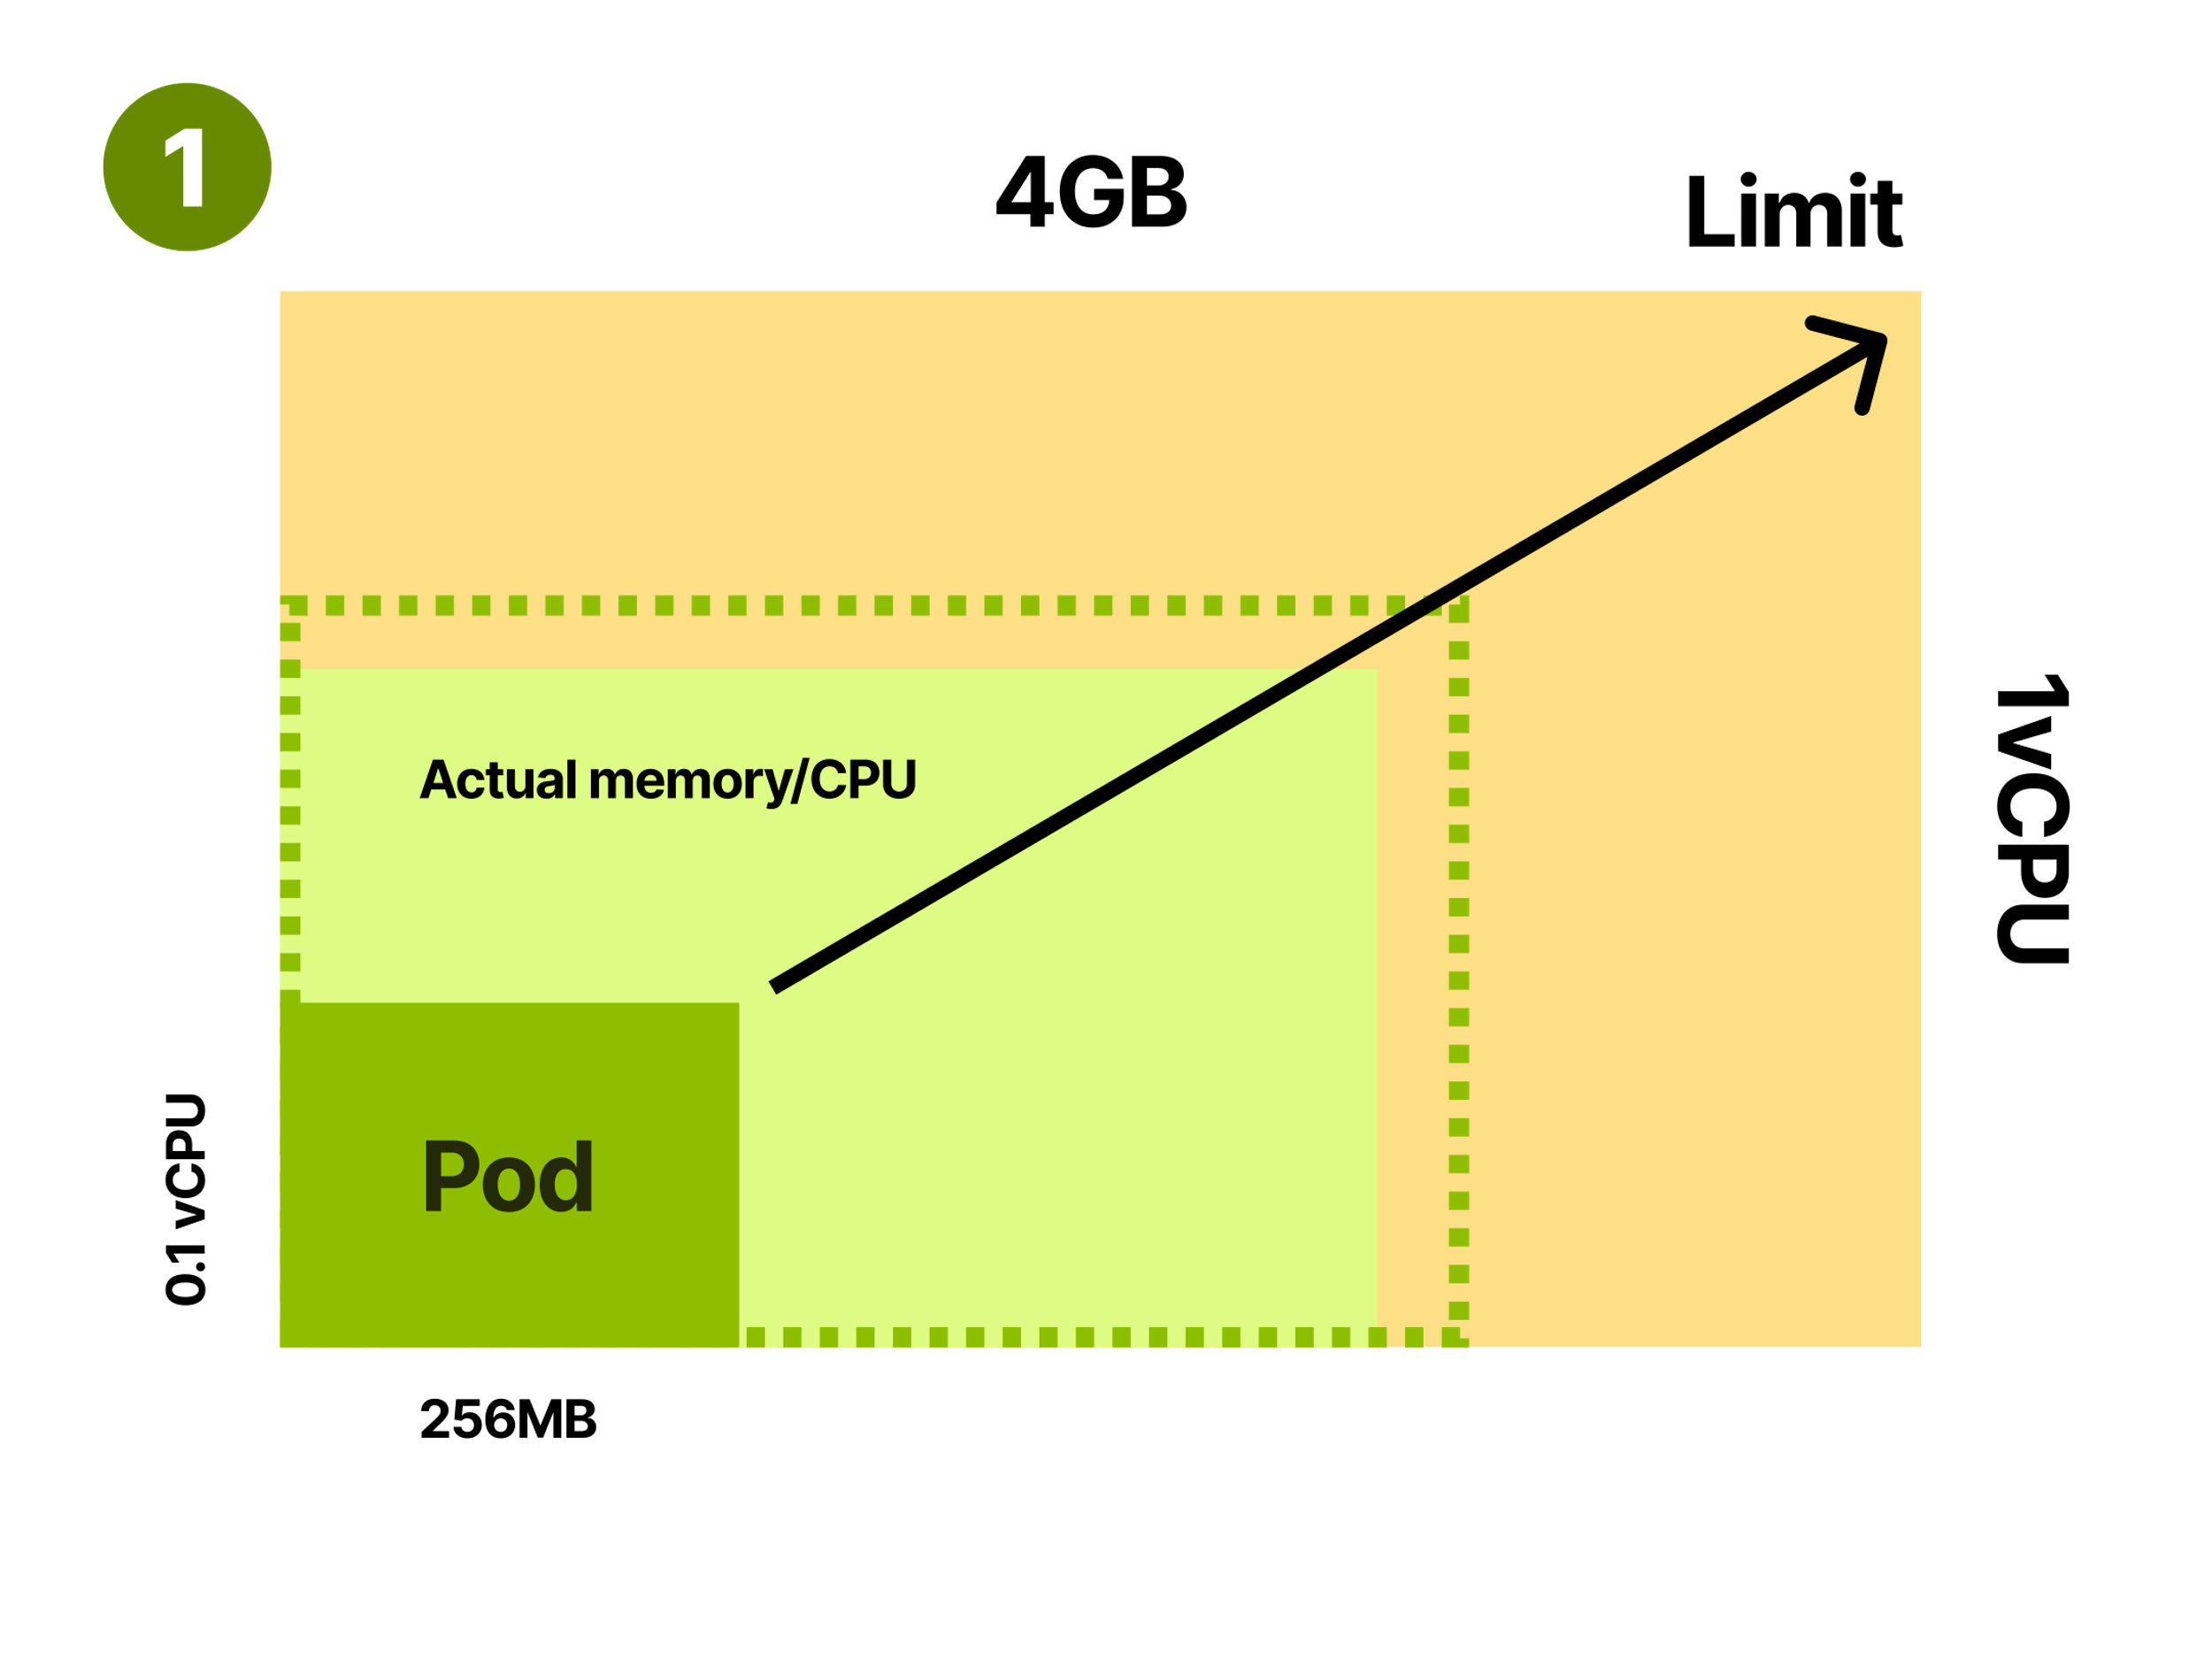
Option#1: Defining requests lower than the actual usage
This is problematic since your nodes will be often overcommitted
Overcommitting nodes can lead to excessive evictions of pods
more work for the kubelet for pod creation/termination
a lot of rescheduling

Slide 46
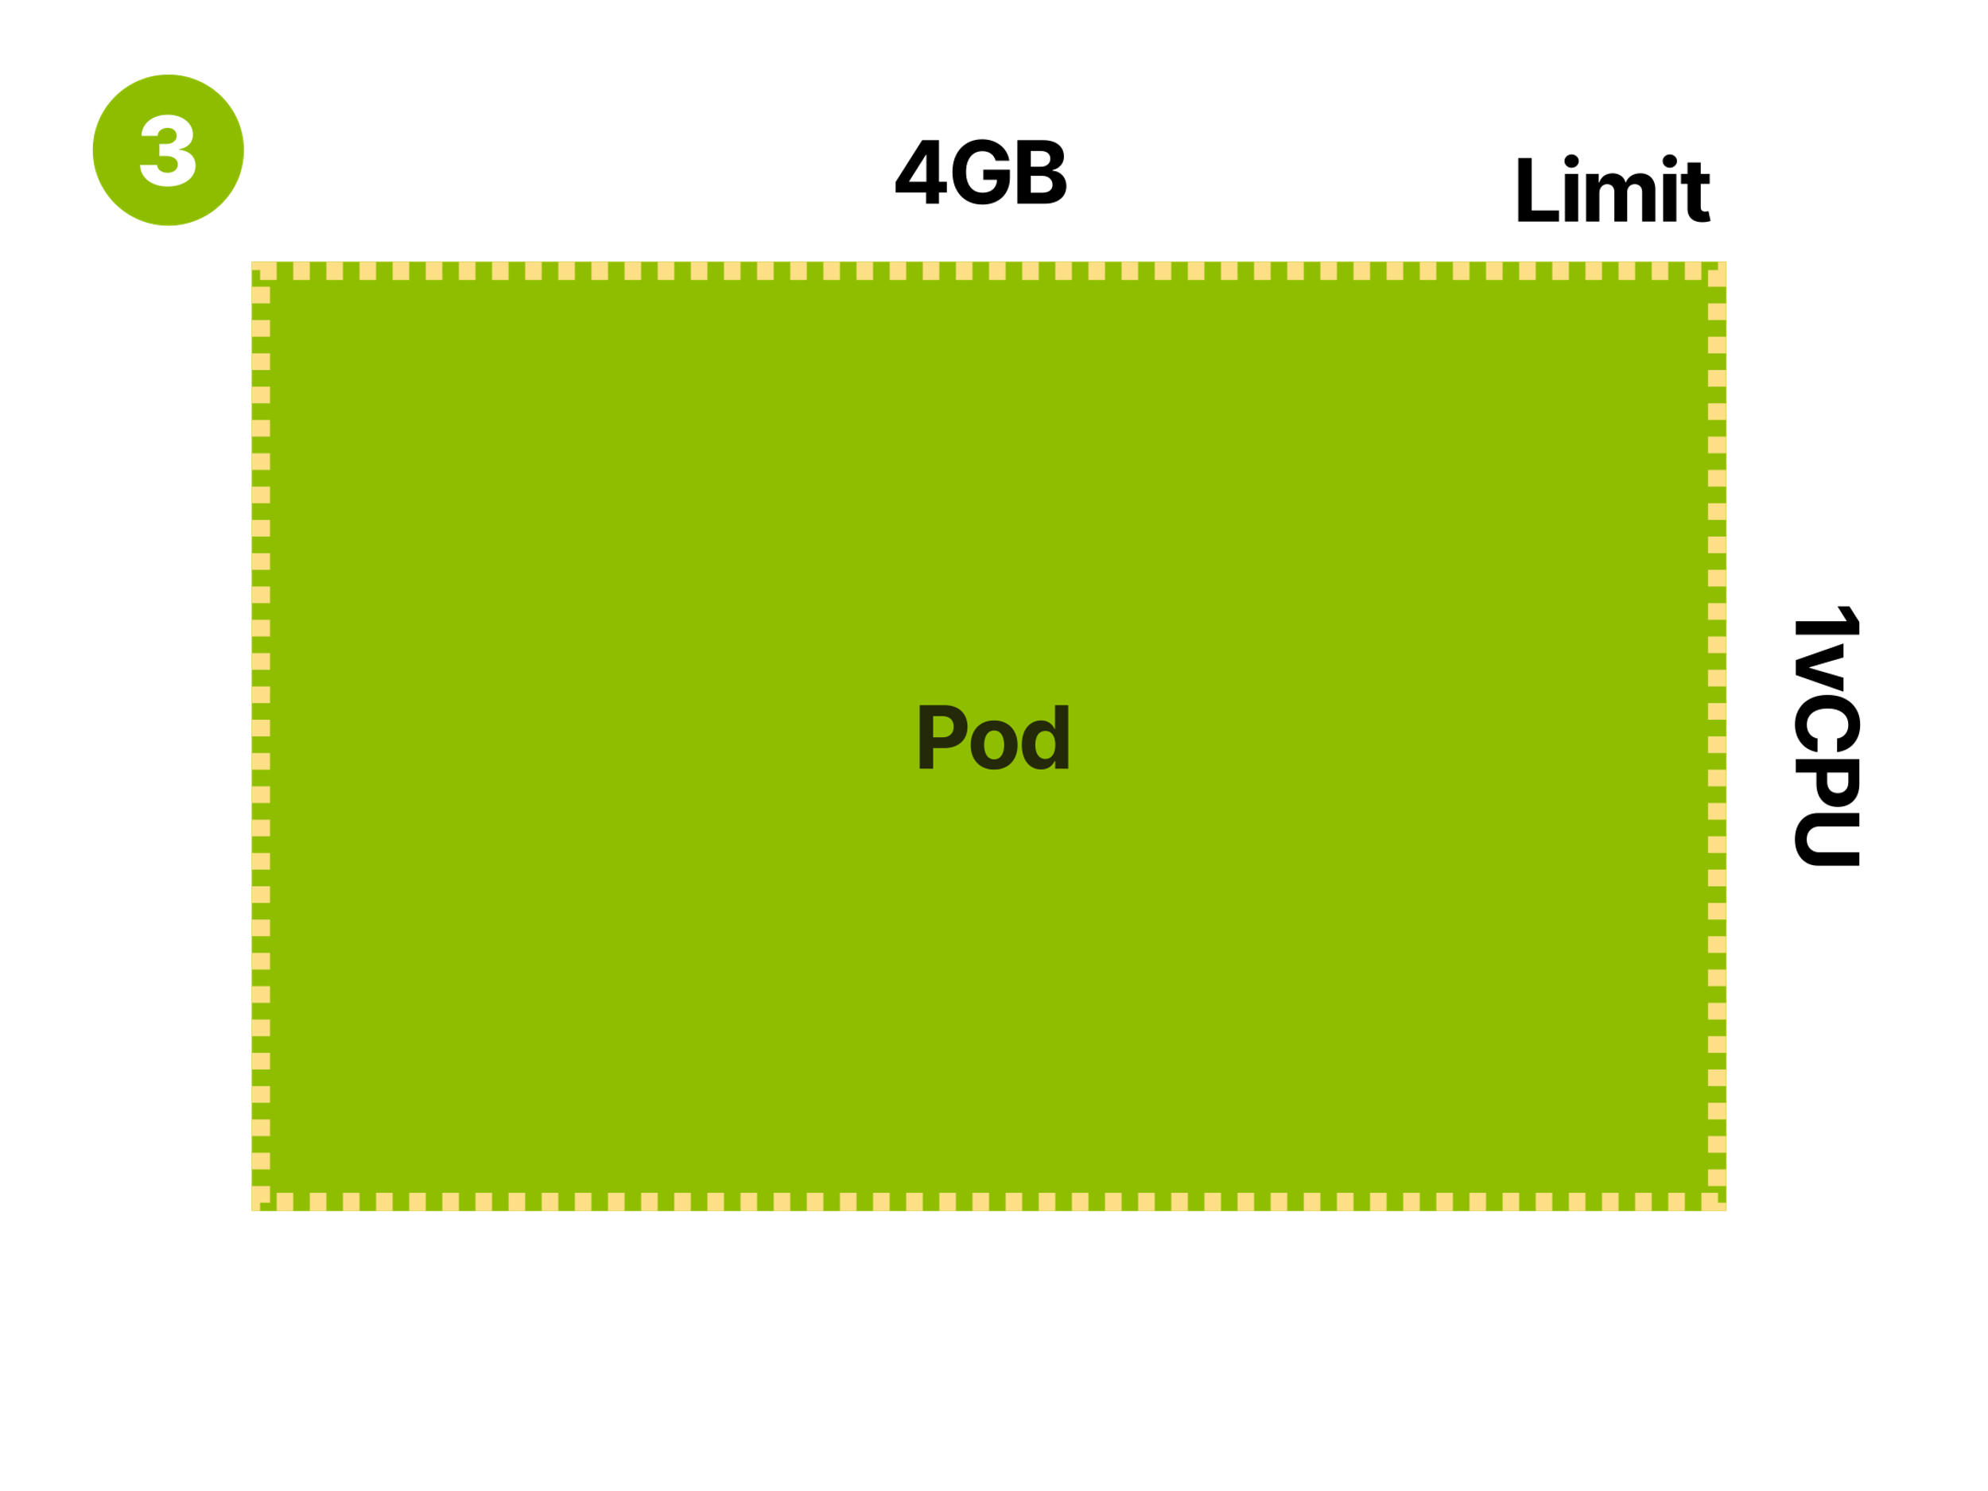
Option#2: Set requests to match the actual limits
In Kubernetes, this is often referred to as Guaranteed Quality of Service class and refers to the fact that it's improbable that the pod will be terminated and evicted.
Pods with Guaranteed Quality of Service are stable but also inefficient.

Slide 47
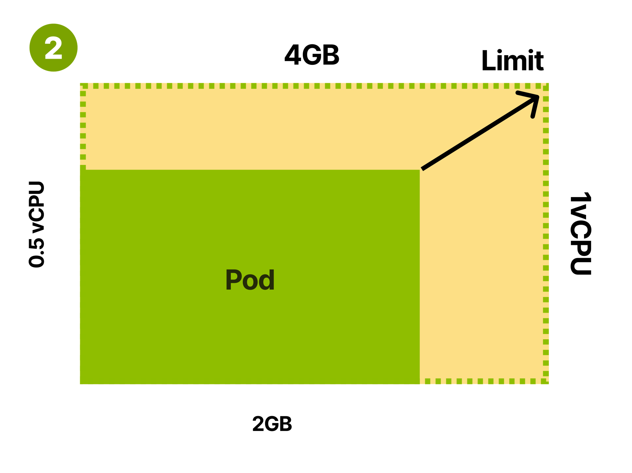
Option#3: Be conservative and assign requests closer to the limit
If you want efficiency, you might want to lower the requests and leave a gap between those and the limit.
This is often referred to as Burstable Quality of Service class and refers to the fact that the Pod baseline consumption can occasionally burst into using more memory and CPU.
If there are resources in the Node, the pod will use them before returning to the baseline consumption.
If the node is low on resources, the pod will compete for resources (CPU), and the kubelet might try to evict the Pod (memory).

Slide 48
Should you use Guaranteed or Burstable quality of Service?
Use Guaranteed Quality of Service when you want to minimize rescheduling and evictions for the Pod – “Stability”
Use Burstable Quality of Service when you want to optimize your cluster and use the resources wisely --- “Efficiency”
The best of both worlds:
Vertical Pod Autoscaler – Google’ Autopilot [1]
The VPA collects the data from the Pod and applies a regression model to dynamically adjust requests and limits.
[1] Rzadca, Krzysztof, et al. "Autopilot: workload autoscaling at google." EuroSys 2020

